Slide 1
CHAPTER 7
Refraction of Light

Slide 2
What is Refraction?
What is Optical Density?
The Laws of Refraction
The Refractive index
Angle of Incidence / Refraction
Total Internal Reflection

Slide 3

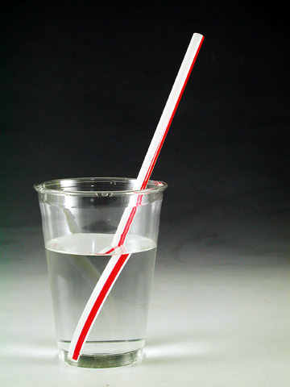
Refraction is the change in direction of light when it passes from one medium to another.

Slide 4
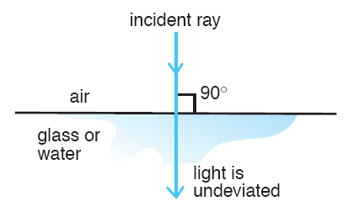
If light ray enters another medium perpendicular to boundary, the ray does not bend.

Slide 5
When the light ray travels from air to water, the refracted ray bends towards the normal.
Incident ray
normal
i
air
i – angle of incidence
water
r
r– angle of refraction
Refracted ray

Slide 6
When the light ray travels from water to air, the refracted ray bends away from the normal.
Refracted ray
normal
r
air
water
i – angle of incidence
i
r– angle of refraction
Incident ray

Slide 7
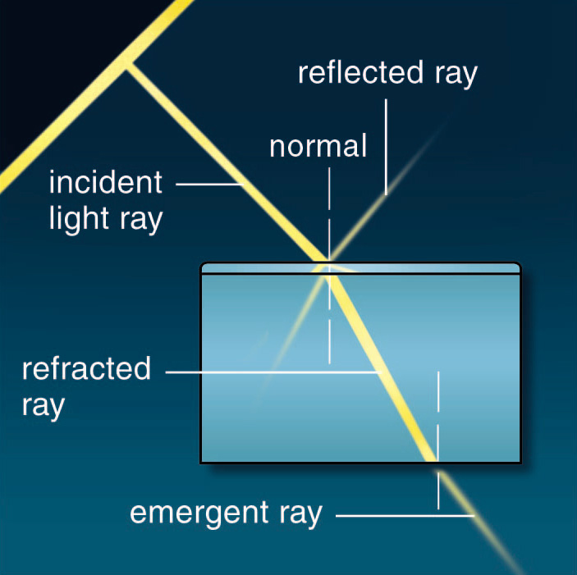
Rectangular block of glass(Perspex)
During refraction, light bends first on passing from air to glass and again on passing from the glass to the air.

Slide 8
When light ray passes through a parallel-sided block of glass it bends twice and returns to its original direction, although slightly shifted to one side.
Incident and emergent rays are always parallel.
Incident ray
Reflected ray
i
air
r
Refracted ray
glass
air
Emergent ray

Slide 9
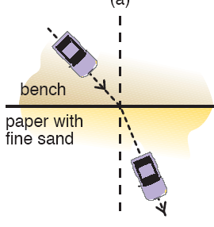
OPTICAL DENSITY
Light slows down when it enters an optically denser medium. The refracted ray bends towards the normal when the second medium is optically more dense than the first.
Incident ray
normal
i
air
water
r
Refracted ray

Slide 10
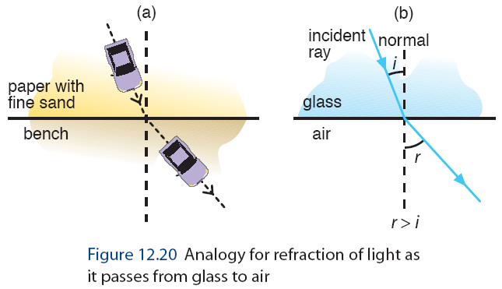
Light speeds up when it enters an optically less dense medium. The refracted ray bends away from the normal when the second medium is optically less dense than the first.
Incident ray
normal
i
water
air
r
Refracted ray

Slide 11
Among the 3 transparent mediums (air, water and glass), glass has the highest optical density.
Incident ray
air
air
i₁
Refracted ray
r₂
i₂
r₁
water
water
r₁
i₂
Refracted ray
Refracted ray
glass
r₂
i₁
glass
Refracted ray
Incident ray

Slide 12
Complete these ray diagrams.
air
water
glass
glass

Slide 13
Complete these ray diagrams.
water
air
air
glass

Slide 14
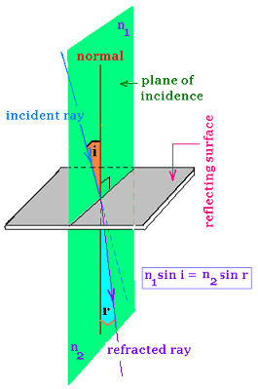
LAWS OF REFRACTION
The incident ray, the refracted ray and the normal at the point of incidence all lie in the same plane.

Slide 15
LAWS OF REFRACTION
Snell’s law
Incident ray
normal
For two given media, the ratio sin i ÷ sin r is a constant,
i is the angle of incidence
r is the angle of refraction
i
air
water
r
Refracted ray
sin i
Refractive Index, n
=
sin r

Slide 16
REFRACTIVE INDEX
The higher the optical density, the greater the refractive index. The greater the refractive index, the greater the bending of light towards the normal.
Incident ray
air
air
i₁
Refracted ray
r₂
i₂
r₁
water
water
r₁
i₂
Refracted ray
Refracted ray
glass
r₂
i₁
glass
Refracted ray
Incident ray

Slide 17
If light is incident upon a piece of glass (refractive index 1.52) at an angle of 45º, what is the angle of refraction?

Slide 18
Given that the refractive index of water is 1.33, calculate the angle of refraction when the incident ray comes in at 60º to the normal.
Solution
sin i
n =
sin r
60º
sin 60º
air
1.33 =
sin r
water
sin 60º
sin r =
r
1.33
r =
40.6º

Slide 19
SPECIAL CASE!
When light travels from a less dense medium to a denser medium…
When light travels from a denser medium to a less dense medium…
sin i
sin r
n =
n =
sin r
sin i
i
i
air
water
water
air
r
r

Slide 20
The figure shows light travelling from water into the air. The ray is incident upon the boundary at 30º. What is the angle of refraction if the refractive index of water is 1.33?
Solution
sin r
n
=
sin i
30º
sin r
=
1.33
water
sin 30º
sin r
1.33
air
=
sin 30º
r
r =
41.9º

Slide 21
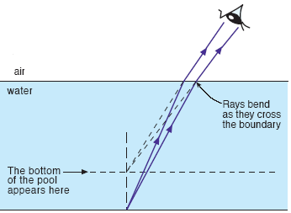

Other ways of calculating the refractive index…
Speed of light in vacuum / air
c
Refractive index, n =
=
v
Speed of light in medium

Slide 22
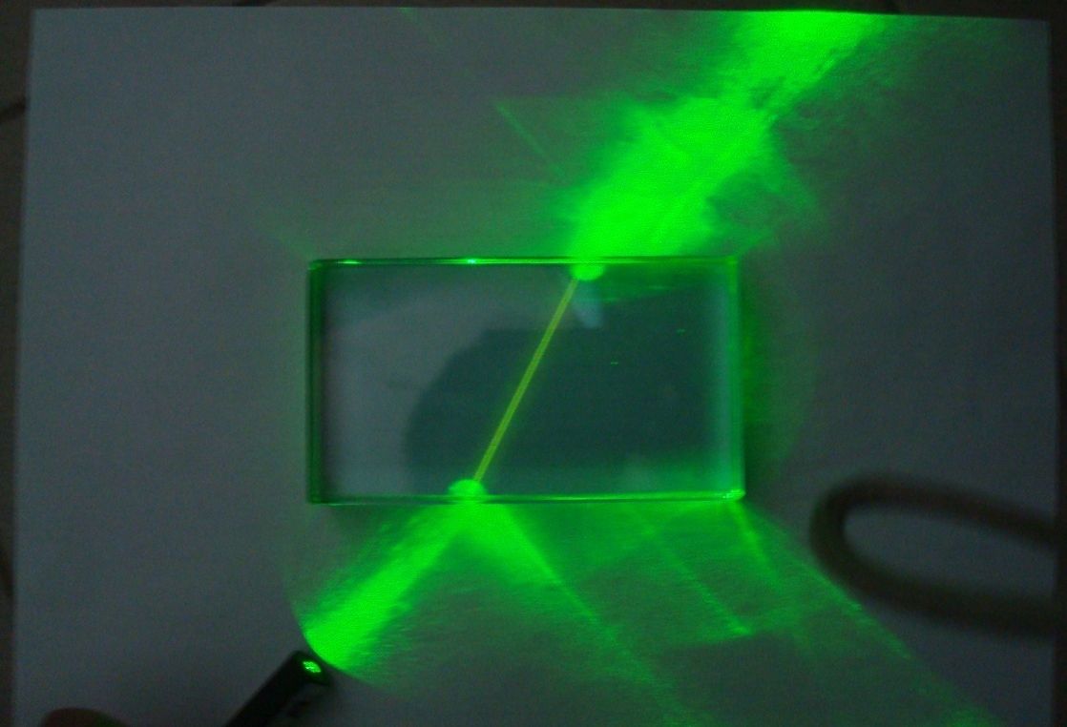
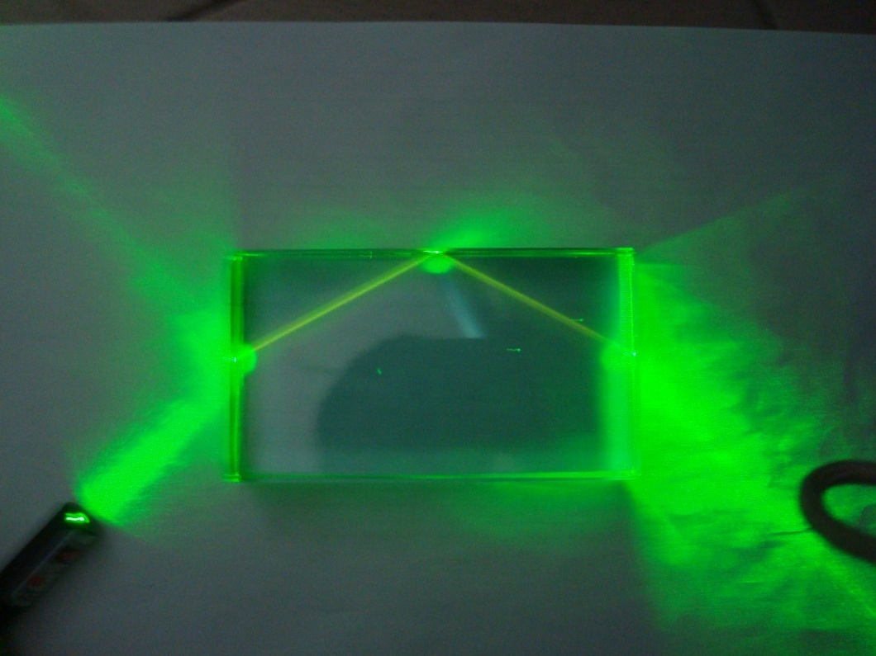
Take a look at this...

Slide 23
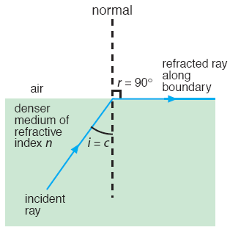
CRITICAL ANGLE
The critical angle c is the angle of incidence in the optically denser medium for which the angle of refraction is 90º.
When i = c
r = 90º

Slide 24

When i > critical angle, the ray gets reflected internally.
This is called TOTAL INTERNAL REFLECTION.

Slide 25

For TOTAL INTERNAL REFLECTION to take place:
The light ray must travel from an optically denser medium towards a less dense one.
Direction of light path
i
The angle of incidence must be greater than the critical angle.

Slide 26
How do we calculate the critical angle?
We know that r = 90º…

Slide 27
We know that when light travels from a less dense medium to a denser medium
Refractive Index, n
sin i
=
sin r
We know that when light travels from a denser medium to a less dense medium
sin r
Refractive Index, n
=
sin i

Slide 28
How do we calculate the critical angle?
We know that r = 90º…
Refractive Index, n
sin r
=
sin i
sin 90º
n
=
sin c
1
=
sin c

Slide 29
How do we calculate the critical angle?
1
sin c
=
n
1
c
sin⁻¹
=
n

Slide 30
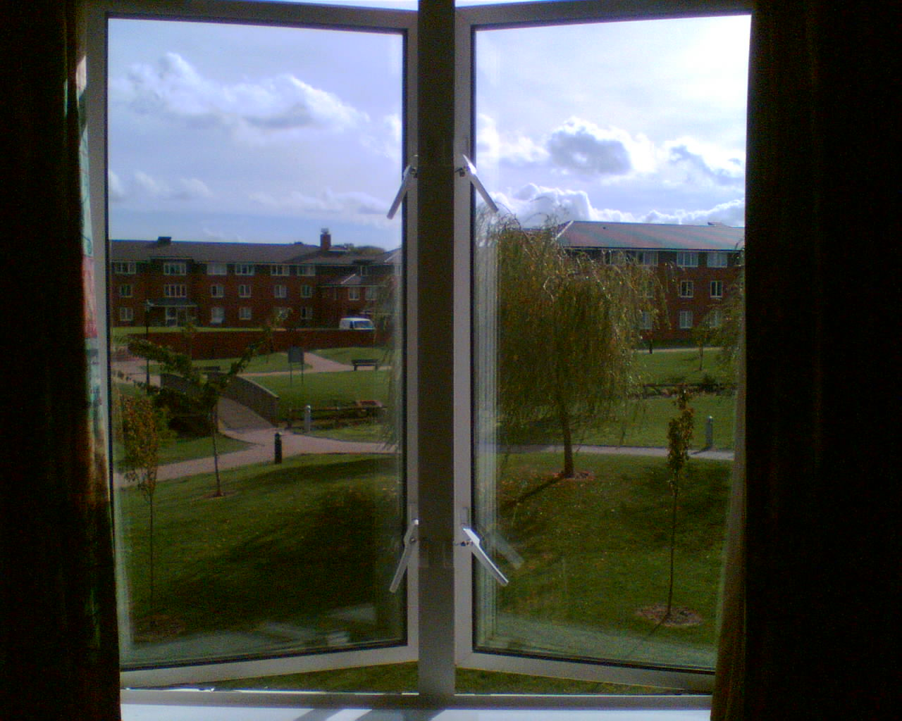
Medium:
Glass
Refractive Index:
1.50
Critical Angle:
1
c
sin⁻¹
=
n
1
=
sin⁻¹
1.50
=
41.8º

Slide 31
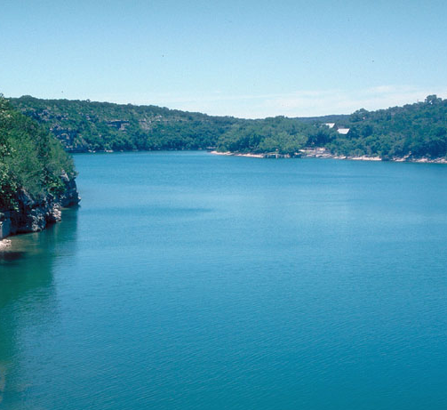
Medium:
Water
Refractive Index:
1.33
Critical Angle:
1
c
sin⁻¹
=
n
1
=
sin⁻¹
1.33
=
48.8º

Slide 32
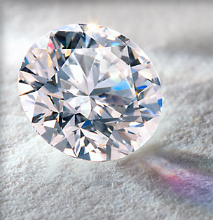
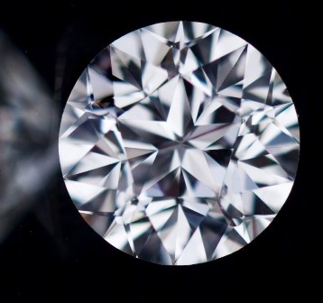
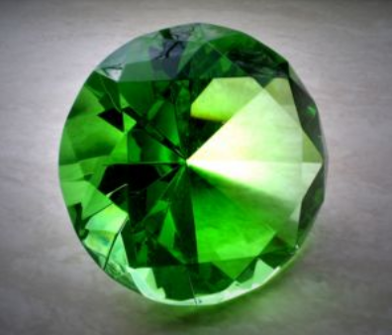
Medium:
Diamond
Refractive Index:
2.42
Critical Angle:
1
c
sin⁻¹
=
n
1
=
sin⁻¹
2.42
=
24.4º

Slide 33
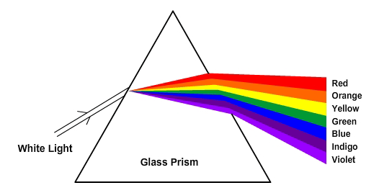
Refraction by a prism
DISPERSION OF LIGHT
The prism refracts each colour by a different amount.

Slide 34
Total Internal Reflection in Prisms

Slide 35
Total Internal Reflection in Prisms

Slide 36
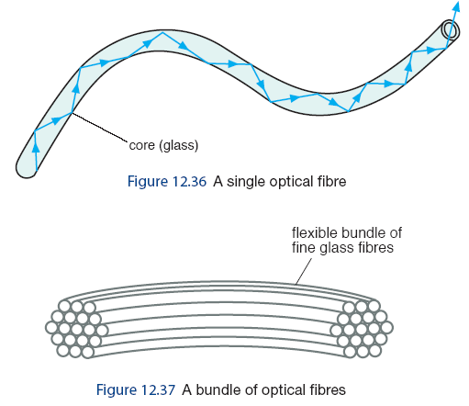
Inside a fibre, light travels along by total reflection.
Optical fibres are
very thin, flexible rods made of special
glass or transparent plastic.

Slide 37
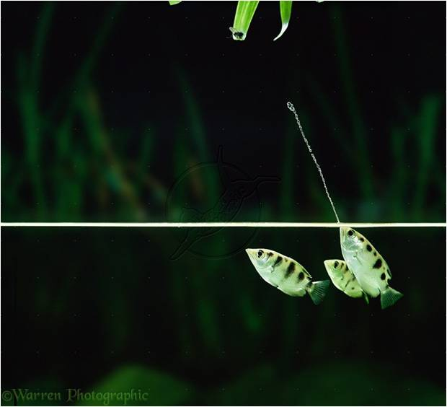
Refractions in real life
The archer fish has adapted to shoot water at insects outside of the water.
It is able to deal with the refraction between the air and water and accurately shoot water at the insects!

Slide 38
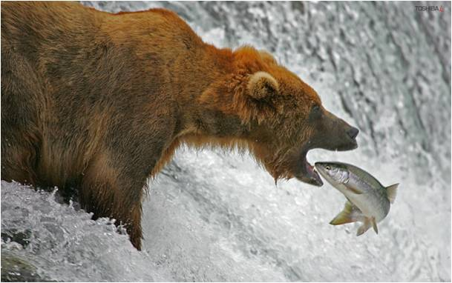
Bears hunting for fish experience a similar problem.
They see the fish beneath the water, but must learn that they are not actually where they appear to be!

Slide 39
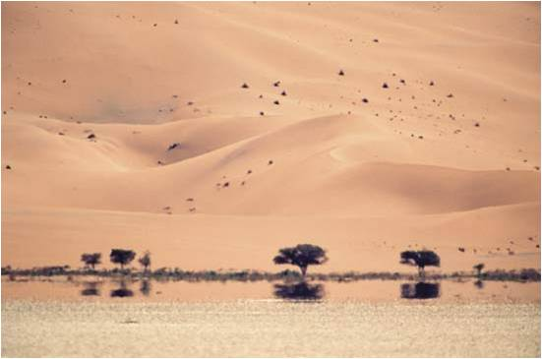
MIRAGES
Mirages occur on very hot days because the density of the air changes due to the temperature.
This can often fool people lost in deserts who are tricked into thinking there is water in the distance….

Slide 40
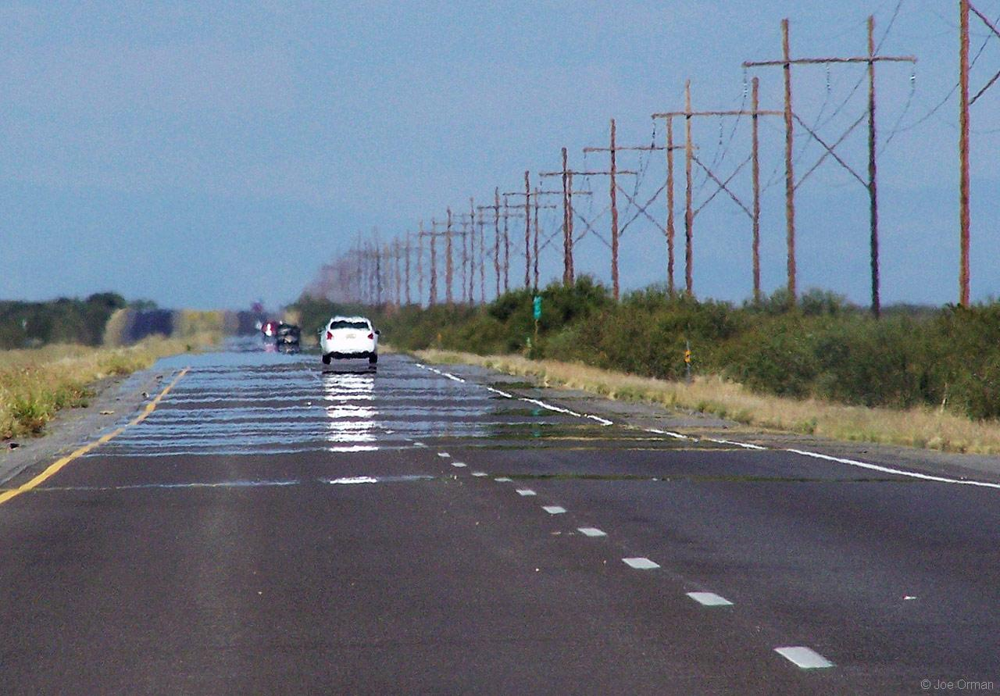
ROADWAY MIRAGES - shimmering pools of water seem to cover the roadway far ahead.

Slide 41
Mirages from the Latin mirare, meaning "to look at, to wonder at", are natural optical phenomena - they are real, objective events, that only cause problems for us when we interpret them incorrectly.
They are formed by the bending, or refracting of light rays through layers of air of differing temperatures.
There are two kinds - inferior and superior; inferior mirages show the false image below the real object, superior mirages show it above. The classic roadway mirage is an inferior mirage - a projection of, e.g. the sky onto hot tar, giving a shimmering wet appearance.

