Slide 1
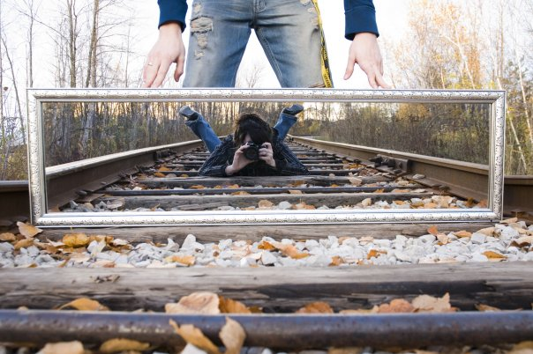
Reflections in a Plane Mirror

Slide 2
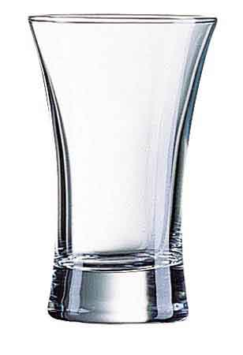
Matter Classified by behaviour when light strikes
Matter | Transparent | Translucent | Opaque
Effect on incident light | Transmits | Transmits some | Absorbs or reflects
Effect on visibility | See through | not clear | Can not see through
Example

Slide 3
Ray Model of Light
Light rays
illustrate the travel of light in a straight line
arrows show the source of the light and the direction of light travel

Slide 4
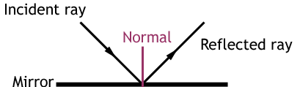
Ray Diagram Terminology
Incident ray – incoming ray that strikes a surface
Reflected ray – ray that bounces off a reflective surface
Normal – perpendicular line to a mirror surface

Slide 5
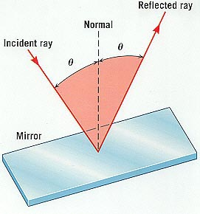
Ray Diagram Terminology
Angle of incidence – angle between the incident ray and the normal
Angle of reflection – angle between the reflected ray and the normal

Slide 6
Reflection Terminology
Reflection: bouncing back of light from a surface
Mirror: any polished surface that exhibits reflection

Slide 7
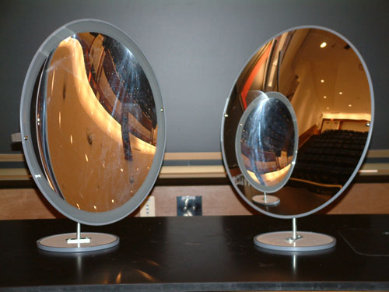
Types of Mirrors
Plane mirror: flat
Curved mirror
a. Concave / converging
b. Convex / diverging

Slide 8
Optics Symbol
Actual Mirror Scientific Mirror Symbol
Reflective surface
Glass
Opaque side
Thin reflective surface

Slide 9
Reflection in a Plane Mirror
Notes:
9

Slide 10
Law of Reflection
When light reflects off a surface, the angle of incidence is always equal to the angle of reflection
∠i = ∠r
Notes:
10

Slide 11
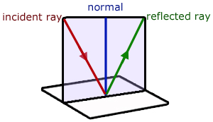
Reflection in a Plane Mirror
Notes:
11

Slide 12
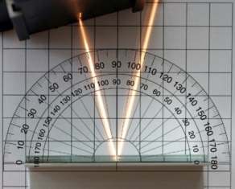
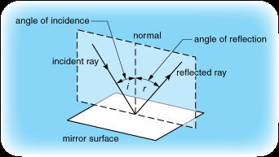
Law of Reflection
The incident ray, the reflected ray and the normal all lie in the same plane.
A light beam reflected off a plane mirror
Notes:
12

Slide 13
Types of Reflection
SPECULAR REFLECTION
Reflection off a smooth surface
DIFFUSE REFLECTION
Reflection off an irregular/dull surface

Slide 14
Reflection Terminology
Reflection: bouncing back of light from a surface
Mirror: any polished surface that exhibits reflection
Image: a reproduction of an original object through the use of light
Virtual image: an image formed by light that does not come from the image location (but it appears to come from the image)

Slide 15
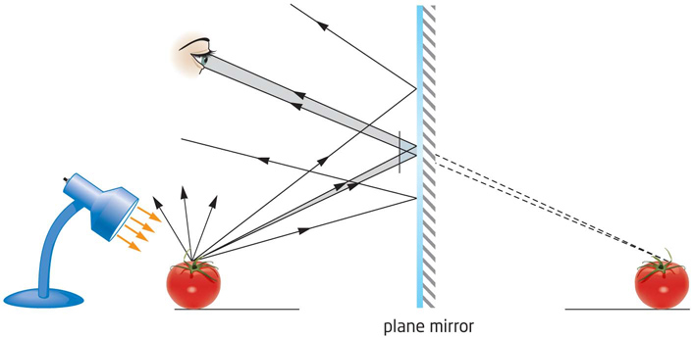
Brain and the plane mirror
Eyes detect reflected light from a plane mirror
Brain projects light rays backwards in a straight line.
Notes:
15

Slide 16
Brain and the plane mirror
Result:
brain thinks there is a light source behind the mirror where the light rays originate
see an image behind the mirror called a virtual image
Result:
brain thinks there is a light source behind the mirror where the light rays originate
see an image behind the mirror called a virtual image
Notes:
16

Slide 17
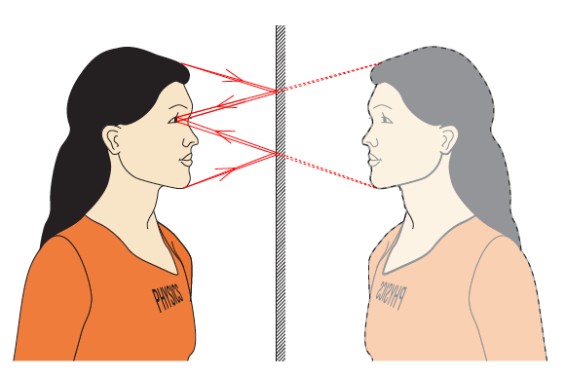
Brain and the plane mirror
Notes:
17

Slide 18
Properties of an image
Type
Attitude
Upright
Inverted (vertical)
Size
Real
Virtual
Laterally Inverted
Enlarged
Same
Reduced

Slide 19
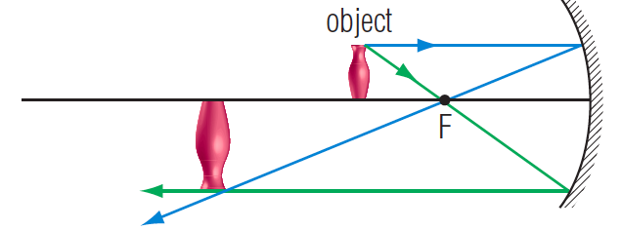
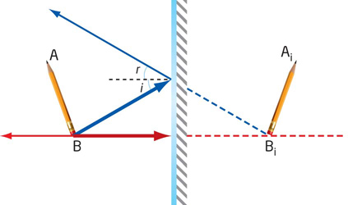
Type
Real - image appears in front of the mirror (could be projected onto a screen)
Virtual - image appears behind the mirror

Slide 20
Virtual image

Slide 21
Size
Enlarged - image is larger than the object
Reduced - image is smaller than the object
Same - image is the same size as the object
a)
b)
c)

Slide 22
Attitude
Upright | Inverted (vertical) | Laterally Inverted
image is right-side up | image is upside-down | image is flipped horizontally
MIRROR
MIRROR
MIRROR

Slide 23
Lateral Inversion
Notes:
23

Slide 24
Summary of Properties of an Image Using S.A.L.T.
Size | Attitude | Location | Type
Larger, same, or smaller | Upright or inverted | Image distance | Virtual or Real

Slide 25
Locating an image in a plane mirror
A. Using Object-Image Lines
B. Using Light Rays (ray diagram)
C. Using both Object-Image lines and Light Rays (ray diagram)
Notes:
25

Slide 26
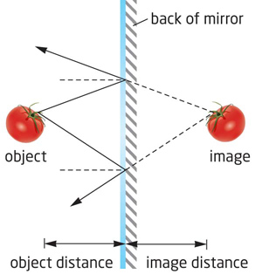
Object distance = Image Distance
Notes:
26

Slide 27
Using object-image lines to locate image in a plane mirror
Solid lines Dashed lines of the same length

Slide 28
Locating an image in a plane mirror
A. Using Object-Image Lines
B. Using Light Rays (ray diagram)
C. Using both Object-Image lines and Light Rays (ray diagram)
Notes:
28

Slide 29
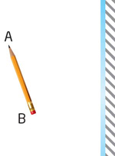
Using light rays to locate image in a plane mirror: Step 1
Identify the top and the bottom of the object (label these “A” and “B”)
Notes:
29

Slide 30
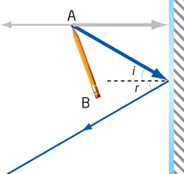
Using light rays to locate image in a plane mirror: Step 2
Draw an incident ray (starting at point A)
Draw a “normal” where the incident ray hits the mirror
Use a protractor to draw a reflecting ray
(Remember that ∠i = ∠r )
Notes:
30

Slide 31
Using light rays to locate image in a plane mirror: Step 3
Repeat step 2 with a second incident ray at a different angle
Draw an incident ray (starting at point A)
Draw a “normal” where the incident ray hits the mirror
Use a protractor to draw a reflecting ray
(Remember that ∠i = ∠r )
Notes:
31

Slide 32
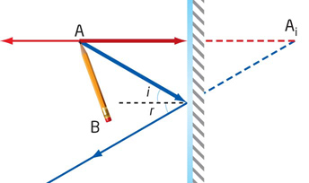
Using light rays to locate image in a plane mirror: Step 4
Extend both reflected rays behind the mirror until they intersect (Ai)
Notes:
32

Slide 33
Using light rays to locate image in a plane mirror: Step 5
Repeat steps 2-4 for Point B
Draw the virtual image using points Ai and Bi as a guide
Notes:
33

Slide 34
Locating an Image in a Plane Mirror (Light rays)
Pick two points on the object (opposite sides)
Draw 2 incident rays
Use the law of reflection to draw the reflected rays (draw normal, measure angle of incidence to determine angle of reflection)
Extend the reflected ray into the virtual side of the mirror (use dotted lines)
Find the intersection of the two extended reflected rays
Repeat for the second point
Using the 2 intersection points to draw the virtual image (dot the lines).

Slide 35
Locating an image in a plane mirror
A. Using Object-Image Lines
B. Using Light Rays (ray diagram)
C. Using both Object-Image lines and Light Rays (ray diagram)
Notes:
35

Slide 36
Using object-image lines and light rays to locate image in a plane mirror: Step 1
Identify the top and the bottom of the object (label these “A” and “B”).
Notes:
36

Slide 37
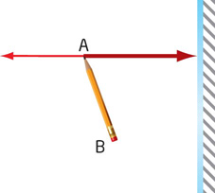
Using object-image lines and light rays to locate image in a plane mirror: Step 2
Draw a line from point A that is perpendicular to the mirror.
Notes:
37

Slide 38
Using object-image lines and light rays to locate image in a plane mirror: Step 3
Draw an incident ray (starting at point A)
Draw a “normal” where the incident ray hits the mirror
Use a protractor to draw a reflecting ray
(Remember that ∠i = ∠r )
Notes:
38

Slide 39
Using object-image lines and light rays to locate image in a plane mirror: Step 4
Extend line A to point Ai (equidistant from point A on the other side of the mirror)
Connect point Ai to your reflection ray
Notes:
39

Slide 40
Using object-image lines and light rays to locate image in a plane mirror: Step 5
Repeat steps 2-4 for Point B
Draw the virtual image using points Ai and Bi as a guide
Notes:
40

Slide 41
Properties of an image in a plane mirror
Same size
Upright
Behind the mirror at the same distance that the object is in front of the mirror
Virtual image
Notes:
41

