Slide 1
Reason vs. Emotion

Slide 2
Reason vs. Emotion
A good start for any new topic can be a video:
http://www.youtube.com/watch?v=qSZDUt2uE6c&feature=related
Then a good discussion about it.

Slide 3
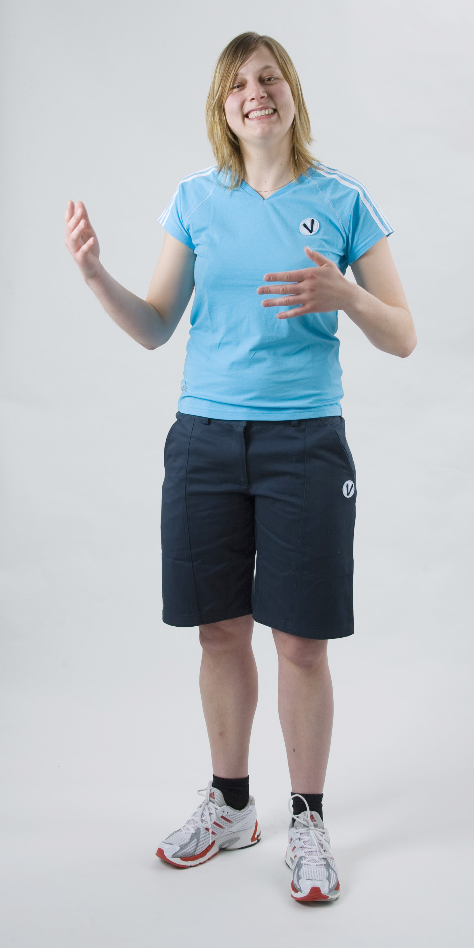
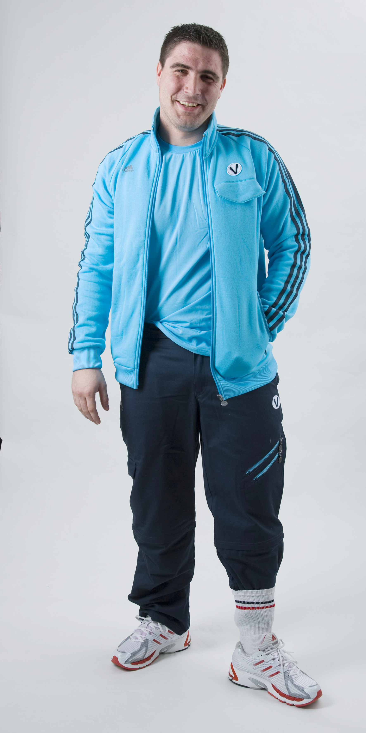
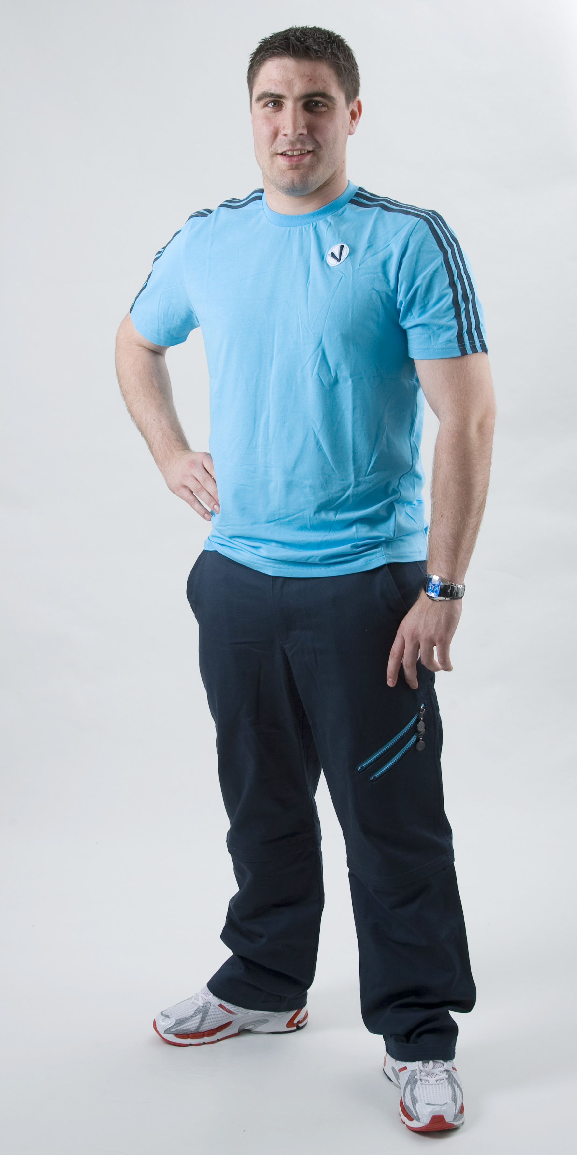
What do you think when you meet these persons?

Slide 4
3 to 5 seconds to judge!
7%
55%
38%
12.01.2016

Slide 5
Are emotions universal?
6 types of emotions seem to be universal
http://www.myvideo.ch/watch/1290607

Slide 6
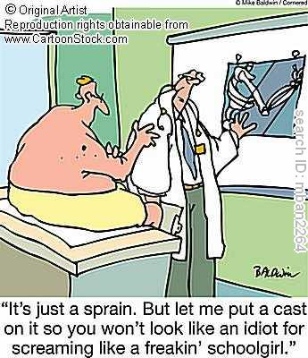
Is pain cultural?
Why do we laugh? http://www.youtube.com/watch?v=hz65AOjabtM
Germany http://www.dailymotion.com/video/x99eth_calcetto-con-dolore_sport
Italy http://www.youtube.com/watch?v=xpEWzkM228w
Boys don’t cry

Slide 7
Pain
NGO: Douleurs sans frontières (www.douleurs.org)
http://www.dailymotion.com/video/x7ecur_arretons-la-douleur-stop-the-pain_creation

Slide 8
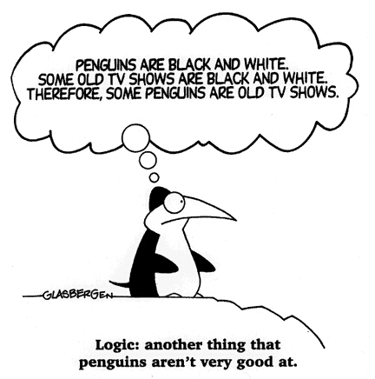
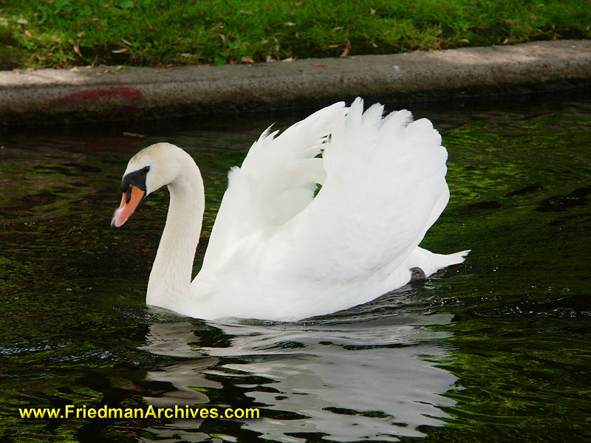
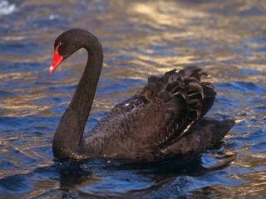
Reason
Deductive reasoning
Inductive reasoning
It is a form of reasoning that moves from the general to the particular.
Syllogisms
Venn diagrams
It is a form of reasoning that goes from the particular to the general.
Generalisation

Slide 9
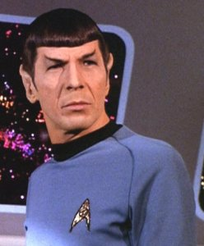
Is Reason always the right answer?
Mr. Spock is the symbole of Logic. http://www.youtube.com/watch?v=y4MupRIpdgQ

Slide 10
Fallacies in reasoning
Fallacies | Definition
Ad ignorantiam | Claiming something is true because it cannot be proved to be false
Hasty generalisation | Generalising from insufficient evidence
Post hoc ergo propter hoc | Confusing a correlation with a causal connection
Ad hominem | Attacking/supporting the person rather than the argument
Circular reasoning | Assuming the truth of what you are supposed to be proving
Special pleading | Using double standards to excuse an individual or group
Equivocation | Using language ambiguously
False analogy | Assuming that because two things are alike in some respects they are alike in other respects
False dilemma | Assuming that only two black and white alternatives exist
Loaded question | A question that biased because it contains a built-in assumption

Slide 11
Then… Is it Faith?
http://fora.tv/2007/07/04/Clash_Between_Faith_and_Reason#fullprogram

Slide 12
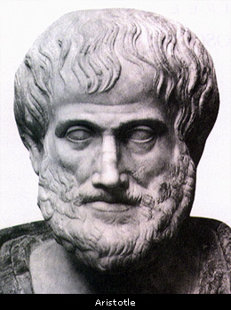
Relation between Reason and Emotion
EMOTION
REASON
Furious
Getting annoyed
Solving a maths problem
Anyone can be angry – that is easy. But to be angry with the right person to the right degree, at the right time, for the right purpose and in the right way – that is not easy. (Aristotle)

Slide 13
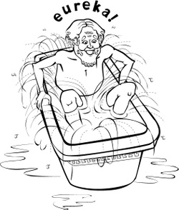
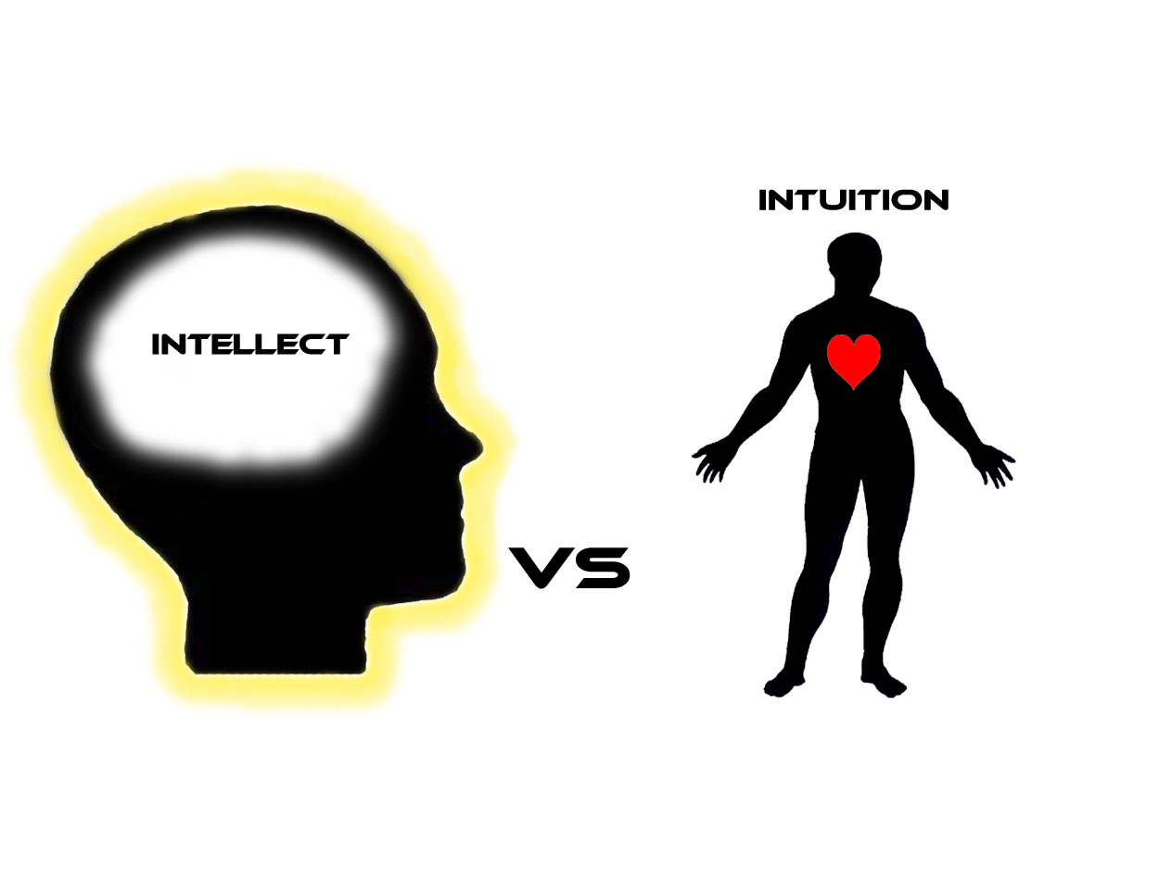
Intuition
Core intuitions (our most fundamental intuitions about life, the universe and everything)
Subject-specific intuitions (intuitions we have in various AOK such as sciences and ethics)
Social intuitions (intuitions about people)

Slide 14
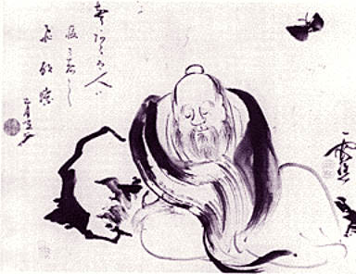
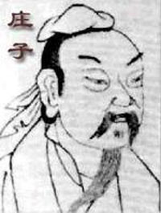
Intuition
Once Zhuang Zhou dreamed he was a butterfly, a fluttering butterfly. What fun he had, doing as he pleased! He did not know he was Zhou. Suddenly he woke up and found himself to be Zhou. He did not know whether Zhou had dreamed he was a butterfly or a butterfly had dreamed he was Zhou. Between Zhou and the butterfly there must be some distinction. This is what is meant by the transformation of things. One night, Zhuangzi dreamed of being a butterfly — a happy butterfly, showing off and doing things as he pleased, unaware of being Zhuangzi. Suddenly he awoke, drowsily, Zhuangzi again. And he could not tell whether it was Zhuangzi who had dreamt the butterfly or the butterfly dreaming Zhuangzi. But there must be some difference between them! This is called 'the transformation of things'. (Zhuangzi, End of Chapter 2)

Slide 15
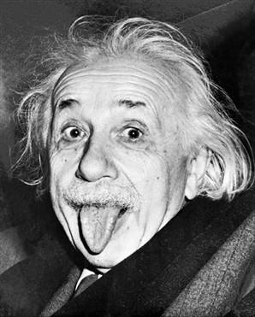
Albert Einstein said:
It is better for people to be like the beasts...they should be more intuitive; they should not be too conscious of what they are doing while they are doing it.

Slide 16
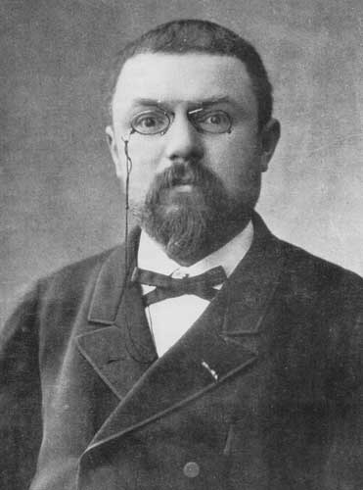
Intuition
For fifteen days I strove to prove that there could not be any functions like those that I have since called Fuchsian functions. I was then very ignorant; every day I seated myself at my work table, stayed an hour or two, tried a great number of combinations and reached no results. One evening, contrary to my customs, I drank black coffee and could not sleep. Ideas crose in crowds; I felt them collide until pairs interlocked, so to speak, making a stable combination. By the next morning I had established the existence of a class of Fuchsian functions, those which come from the hypergeometric series; I only had to write out the results, which took but a few hours. (Henri Poincaré)

Slide 17
Think outside the box!
Connect these X in one line
X X X
X X X
X X X

Slide 18
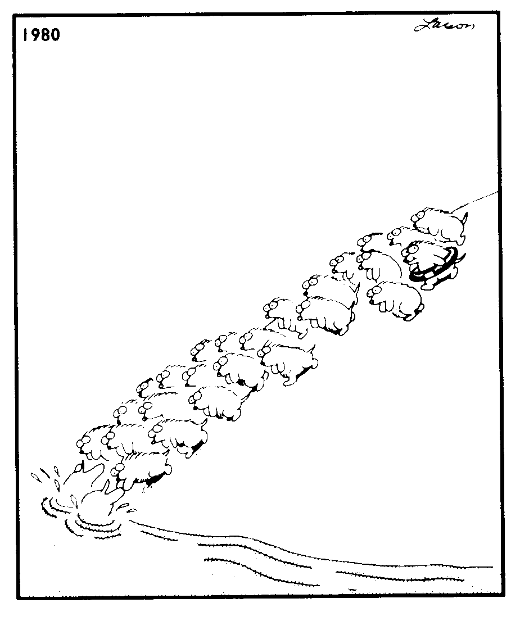
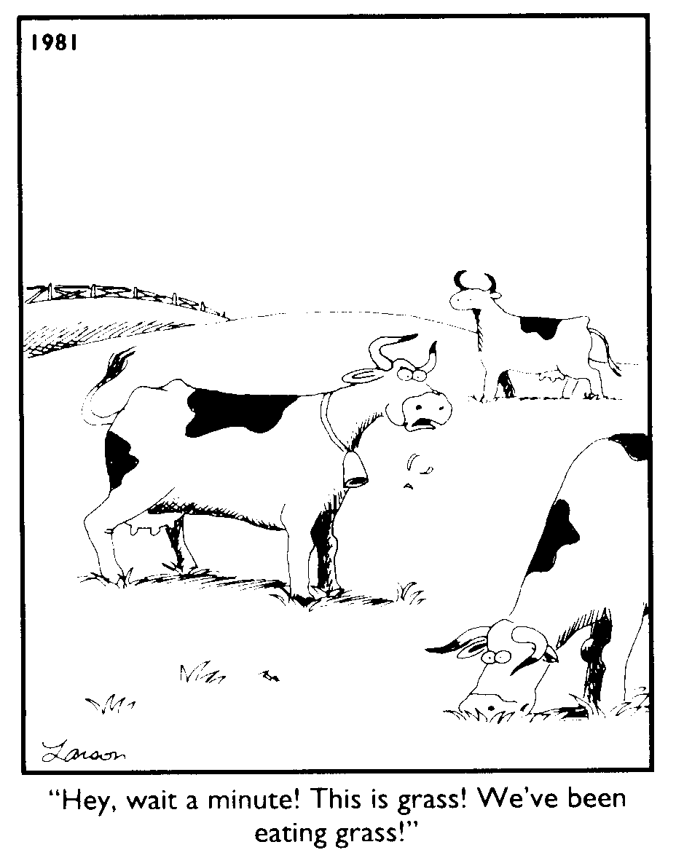
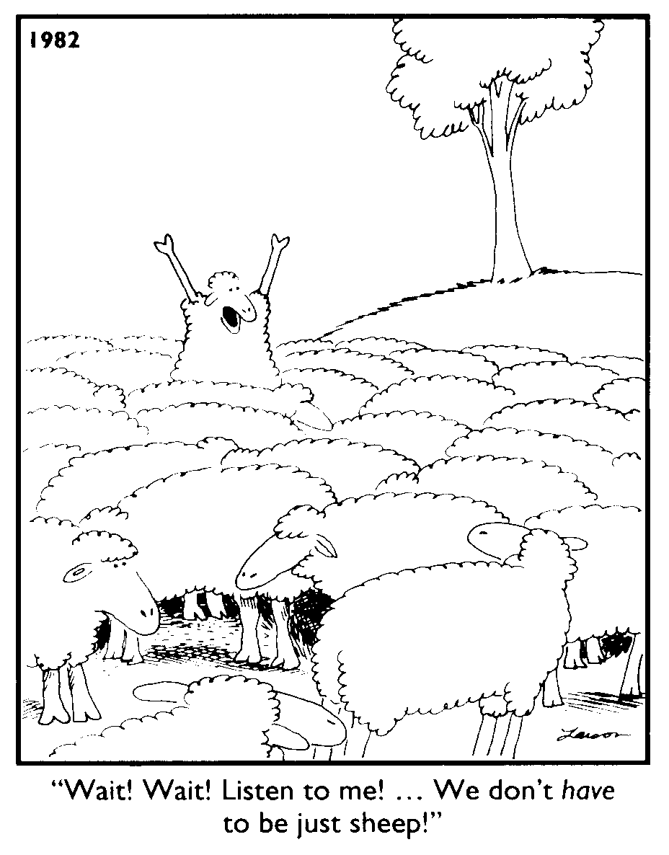
It does help a lot!

Slide 19
Any questions ?

