Slide 1
Natural Sciences

Slide 2
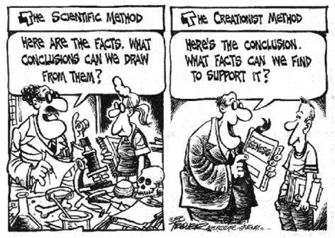
What is the Scientific Method

Slide 3
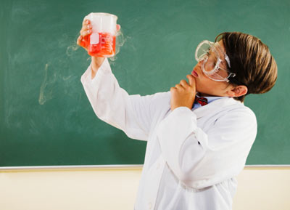
Let’s try it!
Card game

Slide 4
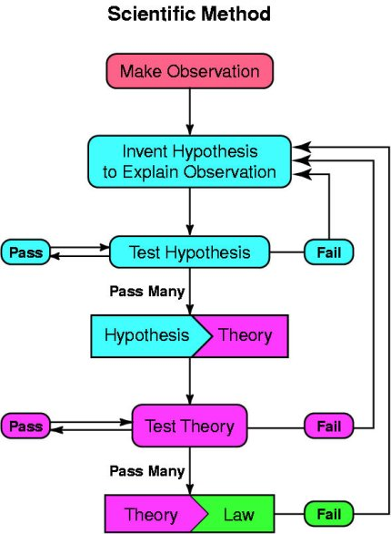
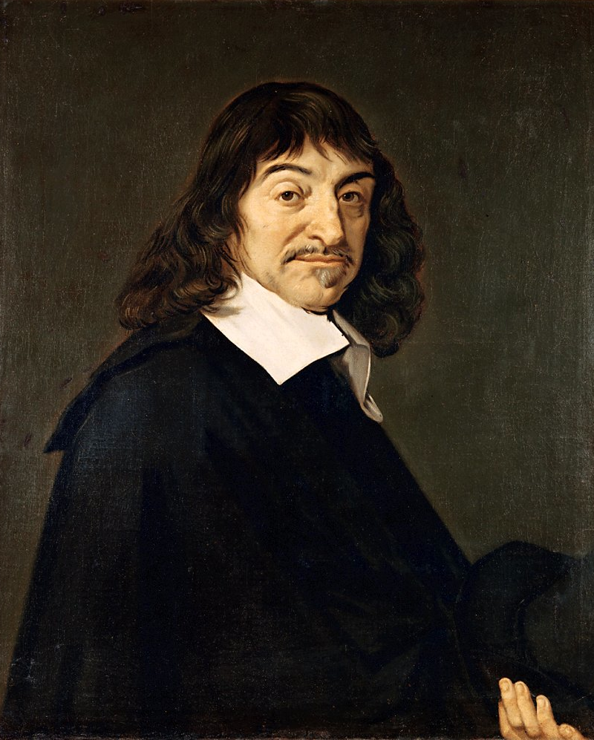
The Scientific Method
I think, therefore I am.

Slide 5
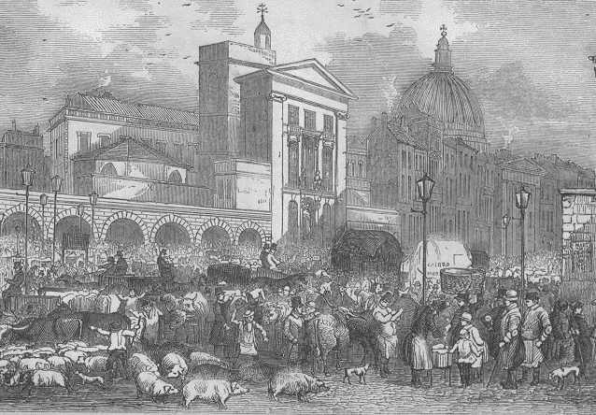
Let’s try it!
Read this article:
DEADLY DISEASE IN CENTRAL LONDON 3 September 1854
The serious outbreak of cholera which has befallen the Soho district of Central London these past days has worsened. This dreadful disease, whose symptoms include severe diarrhoea, continues to claim victims. The death toll from this outbreak has now reached five hundred and shows no sign of slowing down. Why has this disease struck? Some say that there is something in the air...

Slide 6
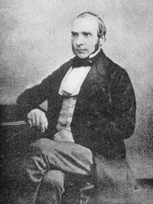
Background
Background information
At this time buildings in the area did not have water supplied through pipes into each home. Instead, people would go to water pumps in the street which were connected to an underground well. They would pump water into buckets and take this back to their homes and use it for washing, drinking and cooking. A doctor, John Snow, was appalled by the cholera outbreak. He visited the area affected and talked to the people that lived there about the disease. He discovered that a large number of people who had died of the disease lived near a water pump on Broad Street and that they had taken water from this pump. John Snow persuaded the local authority to close the pump and soon the number of cholera cases fell dramatically. It was later found that the well that gave water for this pump was near to an underground cesspit full of human sewage which had started to leak out.

Slide 7
Answer the questions:
What is the hypothesis given in the newspaper article for the cholera outbreak?
What was John Snow’s hypothesis for the cholera outbreak?
Give three pieces of evidence from the information above which suggest that John Snow’s hypothesis was valid.
Describe an experiment which coud have given further, direct evidence to back up John Snow’s hypothesis.

Slide 8
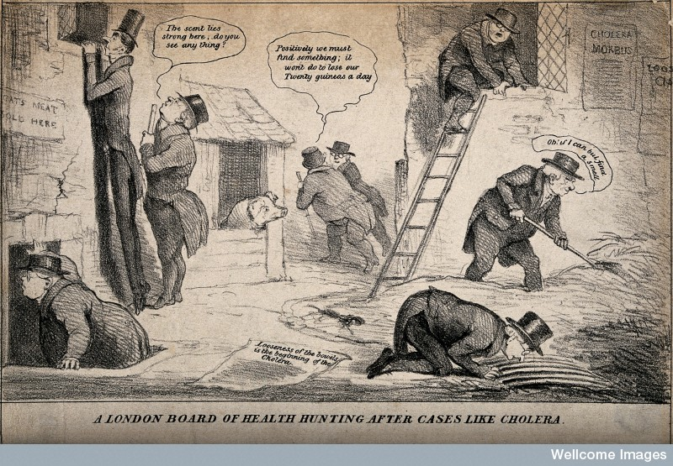
Looking for Cholera

Slide 9
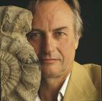
In love with Sciences
After sleeping through a hundred million centuries we have finally opened our eyes on a sumptuous planet, sparkling with colour, bountiful with life. Within decades we must close our eyes again. Isn't it a noble, an enlightened way of spending our brief time in the sun, to work at understanding the universe and how we have come to wake up in it? This is how I answer when I am asked – as I am surprisingly often – why I bother to get up in the mornings. To put it the other way round, isn't it sad to go to your grave without ever wondering why you were born? Who, with such a thought, would not spring from bed, eager to resume discovering the world and rejoicing to be a part of it?
DAWKINS Richard, Unweaving the Rainbow, Penguin, 2006.

Slide 10
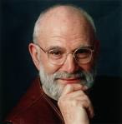
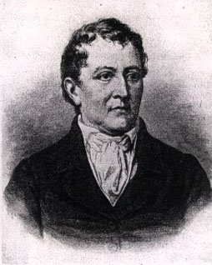
In love with Sciences
Neurologist Oliver Sacks, in his autobiography, Uncle Tungsten (Picador 2002), remembers how inspired he was as a boy by chemistry. He is describing one of his Uncle Dave’s heroes, the 18th century Swedish chemist Scheele:
Scheele, it was said, never forgot anything if it had to do with chemistry. He never forgot the look, the feel, the smell of a substance or the way it was transformed in chemical reactions, never forgot anything he read, or was told, about the phenomena of chemistry. He seemed indifferent, or inattentive to most things else, being wholly dedicated to his single passion, chemistry. It was this pure and passionate absorption in phenomena – noticing everything, forgetting nothing – that constituted Scheele’s special strength. Scheele epitomized for me the romance of science. There seemed to me an integrity, an essential goodness, about a life in science, a lifelong love affair.

Slide 11
Pseudosciences
It is just fake !
But why does it seem to work so well ?
OCEAN | WALL | COFFEE
. . . | . . . | . . .
Animal connected to the ocean | Animal connected to the wall | Animal connected to coffee
. . . | . . . | . . .
Life
Death
Love
Who do you think you are ?
Who do others think you are?
Who are you really ?

Slide 12
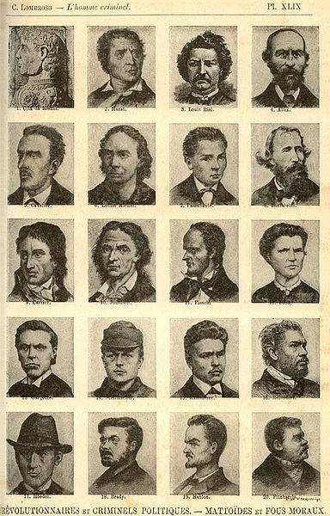
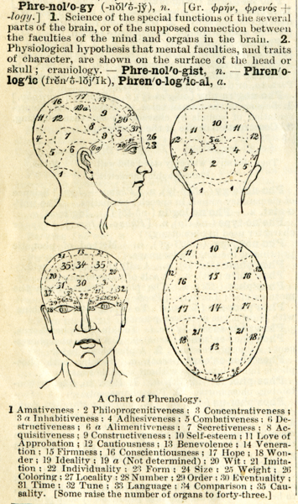
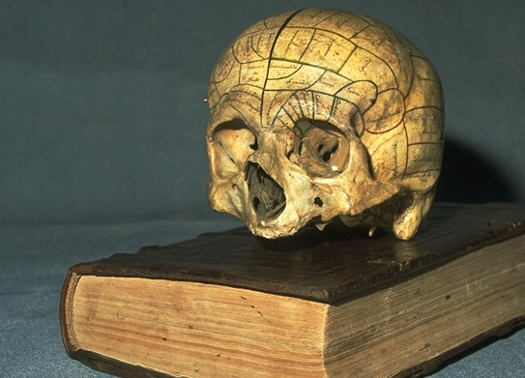
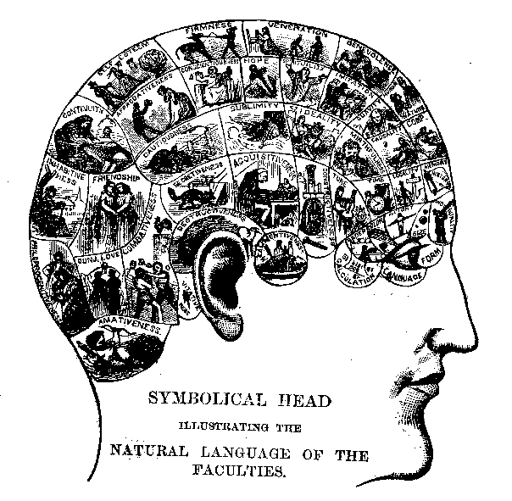
Phrenology
So… How to differentiate science from pseudoscience ?
DANGER !
DANGER !

Slide 13
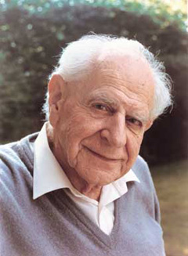
Karl Popper (1902-1994)
Karl Popper’s concern is to distinguish genuine science (Einstein’s theory of relativity) from what he saw as pseudoscience (Marxism and psychoanalysis).
As a young man, Popper was impressed by the ability of theories proposed by people such as Marx, Freud or Adler to explain everything.
Popper arrived at the conclusion that this was a weakness.

Slide 14
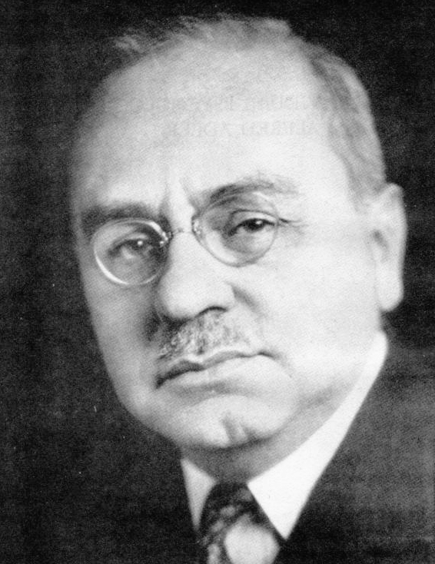
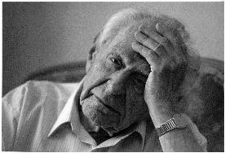
Alfred Adler
Alfred Adler (1870-1937) thinks that « To be human means to feel inferior ».
Imagine that a man is walking along the bank of a fast-flowing river when he sees a child fall in. He has two choices: to jump or not.
If he jumps, Adler can say: « This is exactly what my theory predicted: the man was clearly trying to overcome his feeling of inferiority by demonstrating his bravery. »
If he doesn’t jump, he can say: « Just as I thought, this man is clearly suffering from an inferiority complex which he is unable to overcome. »
Why does Popper disagree ?

Slide 15
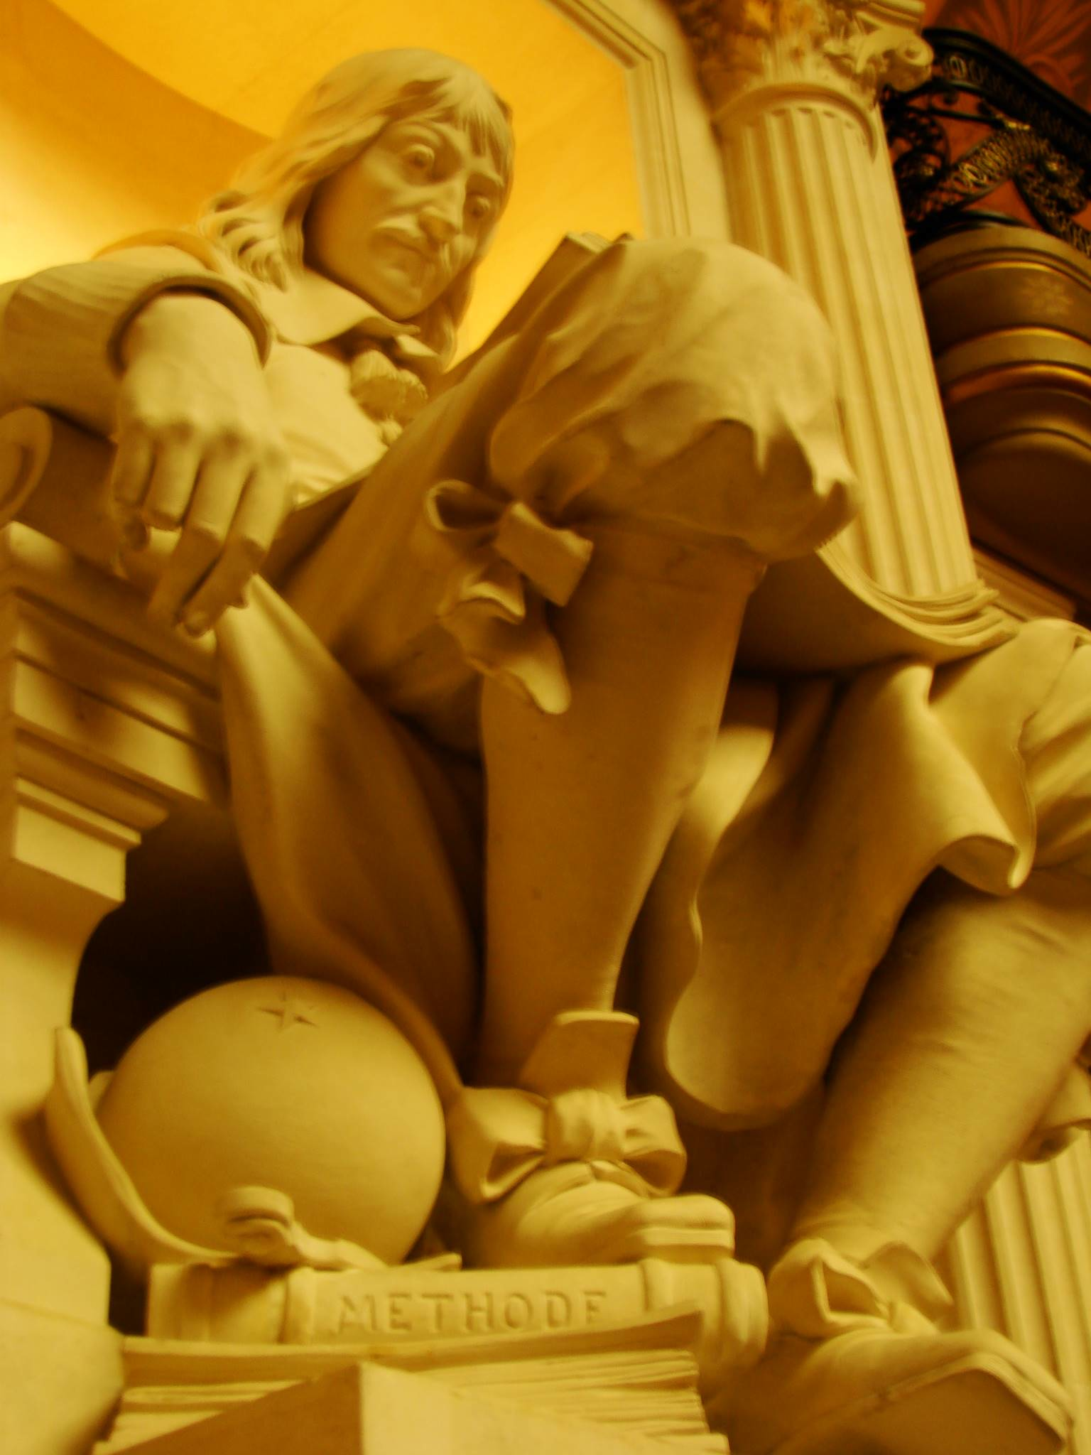
The answer is:
FALSIFICATION.
http://www.stephenjaygould.org/ctrl/popper_falsification.html

Slide 16
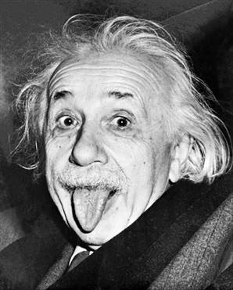
Albert Einstein said:
The most incomprehensible thing about the world is that it is comprehensible.

Slide 17
Any questions ?

