Slide 1
MEASURING LENGTH AND TIME

Slide 2
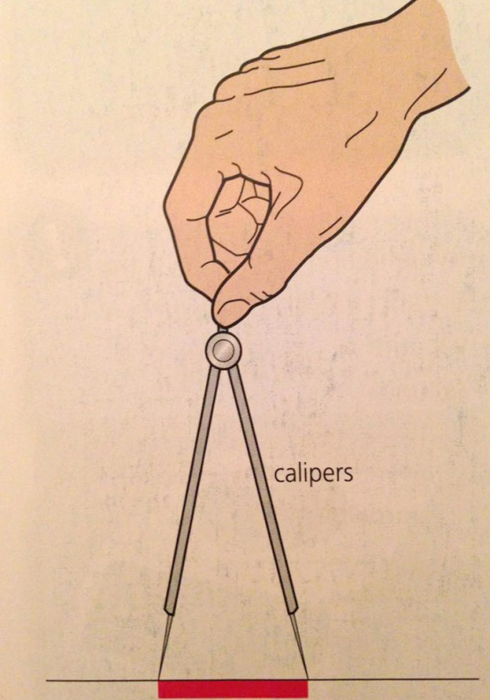
Measuring length
Common tool for the lengths from a few millimeters up to a meter is a rule
Calipers are used in cases when it is impossible to put object next to a scale

Slide 3
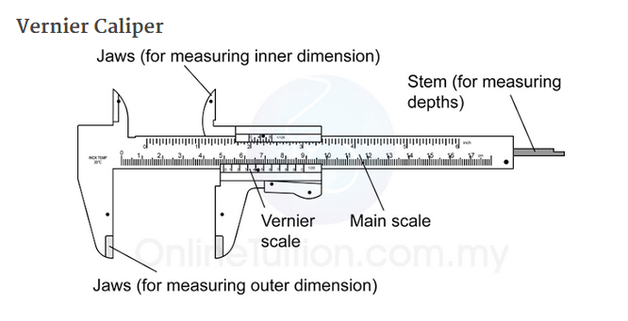
More accurate length measurements
For greater precision in measurements we use
Vernier caliper or Micrometer screw gauge

Slide 4
Using Vernier callipers
The main scale and the vernier scale give a measurement of a distance between the two inner
faces of the jaws.
example in Figure
thickness of rod
= main scale reading + vernier
reading
= 35mm+0.7mm = 35.7mm
First read the highest scale division on main scale just left of the zero and then, look at the vernier scale where division coincide . This is the fraction of a millimetre that you must add to the first reading.

Slide 5
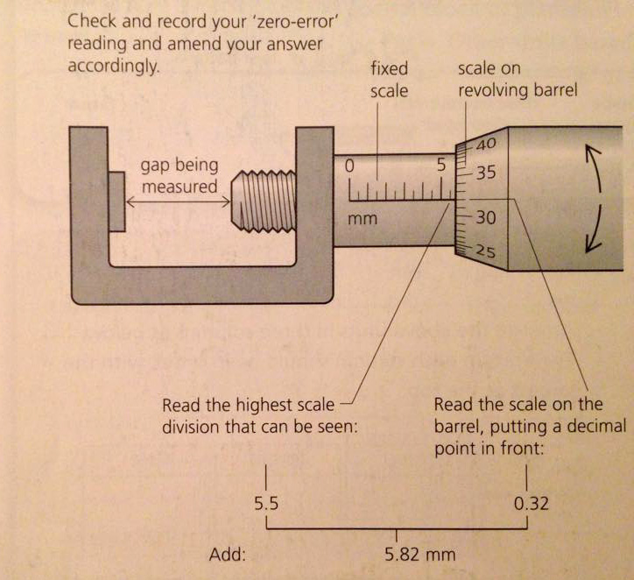
Micrometer screw gauge

Slide 6
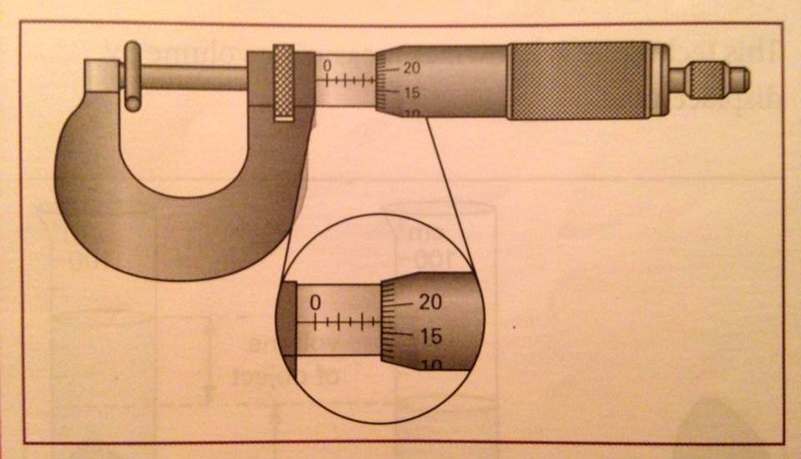
How to use micrometer
The main scale is on the shaft, and the fractional scale is on the rotating barrel.
The fractional scale has 50 divisions, so that one complete turn represents 0.50mm

Slide 7
Turn the barrel until the jaws just tighten on the object
(a clicking sound is heard)
Read the main scale to the nearest 0.5mm
Read the additional fraction of a millimeter from the fractional scale
example in Figure
thickness of rod
= main scale reading + fractional scale reading
= 2.5mm+0.17mm= 2.67mm

Slide 8
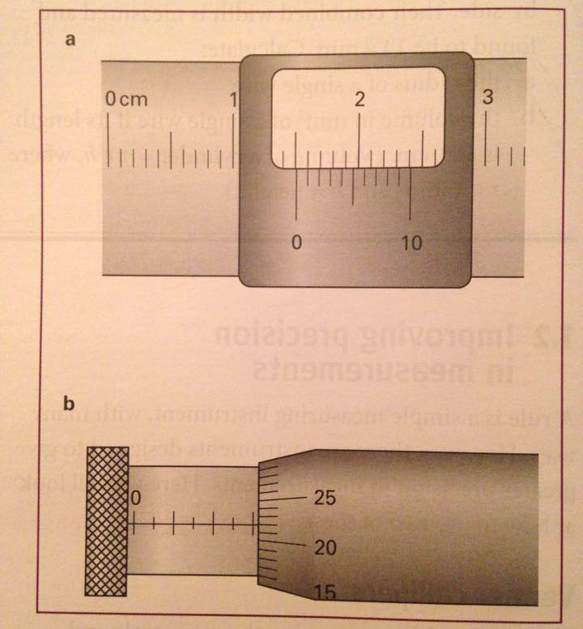
State the measurements shown in Figure bellow

Slide 9
Measuring time
time intervals of many seconds or minutes can be measured using a stopclock or a stopwatch
instruments can have analog and digital display
making accurate measurement with hand-operated stopwatch is sometimes difficult
for a rapidly moving object between two points time is measured using light gates connected to an electronic timer
example - measuring period of a pendulum
since swings are small and at steady rate we can use a stopwatch to measure the time for large number of swings and calculate the average time per swing

Slide 10
Question
A pendulum is timed, first for 20 swings and then for 50 swings:
time for 20 swings = 17.4s
time for 50 swings = 43.2s
Calculate the average time per swing in each case. The
answers are slightly different. Can you suggest any
experimental reason for this?
Useful links:
https://www.youtube.com/watch?v=FNdkYIVJ3Vc
https://www.youtube.com/watch?v=qXtE07tbK8s
https://www.youtube.com/watch?v=I-RZxhyZVio
https://www.youtube.com/watch?v=StBc56ZifMs

