Slide 1
Magnets and currents
Magnets
Magnetic fields
Magnetic effect of a current

Slide 2
Magnets
Magnets have a force if you put iron filings nearby .
Magnets have north-seeking pole (or N pole for short)
The south- seeking pole (S pole)
The closer the poles, the greater the force between them.

Slide 3
If you bring the ends of two similar bar magnets together, there is a force between the poles: like poles repel, unlike poles attract

Slide 4
Induced magnetism
Materials such as iron and steel are attracted to magnets because they themselves become magnetized when there is a magnet nearby.
The iron loses virtually all of its induced magnetism- it was only a
temporary magnet.

Slide 5
The induced pole nearest the magnet is the opposite of the pole at the end of the magnet.

Slide 6
Making a magnet
The steel keeps some of its induced magnetism and becomes a permanent magnet,
The most effective method of magnetizing it is to place it in a long coil of wire and pass a large direct current through the coil.
The current has a magnetic effect which magnetizes the steel.

Slide 7
Hard magnetic materials,
such as steel, and alloys called Alcomax and Magnadur, are difficult to magnetize but do not readily lose their magnetism.
Soft magnetic materials,
such as iron and Mumetal (nickel-iron alloy)
are relatively easy to magnetize, but their magnetism is only temporary.
Non-magnetic materials
include metals such as brass, copper, zinc, tin(Sn) and aluminium as well as non-metals.

Slide 8
Where magnetism comes from
In an atom, tiny electrical particles called electrons move around a central nucleus. Each electron has a magnetic effect as it spins and orbits the nucleus.
You know that an electrical current moving through a wire creates a magnetic field.

Slide 9
In an unmagnetized material, the atomic magnets point in random directions.
When materials become magnetized, more and more of their atomic magnets line up with each other.
Together, billions of tiny atomic magnets act as a big magnet.

Slide 10
Magnetic fields
A magnetic field is the area of influence exerted by a magnetic force.
Magnetic field is around the magnet, and this exerts forces on magnetic materials in it.

Slide 12
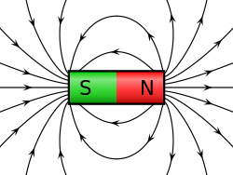
Magnetic fields can be investigated using a small compass.
The needle is a tiny magnet which is free to turn on its spindle.
When near a magnet, the needle is turned by forces between its poles and the poles of the magnet.

Slide 13
We can draw field lines by starting with the compass in different positions.

Slide 14
Between magnets with unlike poles

Slide 16
Between magnets with like poles

Slide 18
The earth’s magnetic field

Slide 19
The Earth has a magnetic field.
With no other magnets near it, a compass needle lines up with the Earth’s magnetic field. The N end of the needle points north.
N pole is always attracted to an S pole.
So it follows that the Earth’s magnetic S pole must be in the north!

Slide 20
Magnetic north is over 1200km away from the Earth’s geographic North Pole. Earth’s magnetic axis is not quite in line with its north-south axis of rotation.

Slide 21
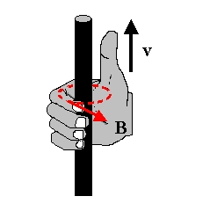
Magnetic effect of a current
Magnetic field around a wire
A rule for field direction
Using your right-hand:
Curl your fingers into a half-circle around the wire, they point in the direction of the magnetic field, B
Point your thumb in the direction of the conventional current.

Slide 22
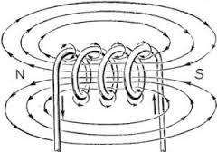
Magnetic fields from coils

Slide 23
A rule for poles

Slide 24
Summary
Together, billions of tiny atomic magnets act as a big magnet.
The Earth has a magnetic field
A rule for field direction
A rule for poles

Slide 25
Electromagnets
When a current flows through the coil, it produces a magnetic field.
The strength of the magnetic field is increased by:
Increasing the current
Increasing the number of turns in the coil
Reversing the current reverses the direction of the magnetic field

Slide 26
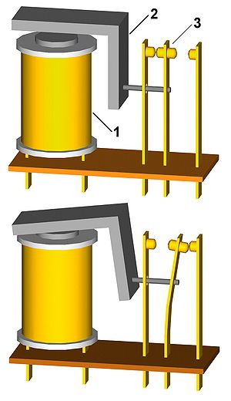
The magnetic relay
A magnetic relay is a switch operated by an electromagnet.
With a relay, a small switch with thin wires can be used to turn on the current in a much more powerful circuit- for example, one with a large electric motor in it.

Slide 27
Magnetic storage
Many people still use magnetic tape for recording sounds and TV pictures.
The tape consists of long, thin, plastic strip, coated with a layer of iron oxide or similar material. Ones magnetized it keeps its magnetism, but is relatively easy to demagnetized, ready for another recording

Slide 28
Recording on magnetic tape
The incoming sound waves are used to vary the current through a tiny electromagnet in the recording head.
As the tape moves past the head, a track of varying magnetism is created along the tape.
(computer hard drive/used to create tracks of varying magnetism on a spinning disc)

Slide 30
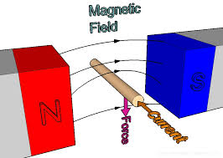
Magnetic force on a current
When a length of copper wire, with a current passing through it, has been placed in a magnetic field, there is a force on the wire.
(The current produces its own magnetic field which acts on the poles of the magnet.)

Slide 31
The force is increased if:
The current is increased
A stronger magnet is used
The length of wire in the field is increased

Slide 32
Fleming’s left-hand rule

Slide 34
Turning effect on a coil- the coil below lies between the poles of a magnet. The current flows in opposite directions along the two sides of the coil-according to Flaming’s left-hand rule, one side is pushed up and other side pushed down. There is a turning effect on the coil

Slide 35
Electric motors A simple DC motor

