Slide 1
IGCSE PHYSICS Mains Electricity
Textbook IGCSE Physics pages 192 to 195

Slide 2
IGCSE Specification
Electricity
Mains electricity
recall the hazards of electricity including frayed cables, long cables, damaged plugs, water around sockets, and pushing metal objects into sockets
describe the uses of insulation, double insulation, earthing, fuses and circuit breakers in a range of domestic appliances
know some of the different ways in which electrical heating is used in a variety of domestic contexts
understand that a current in a resistor results in the electrical transfer of energy and an increase in temperature
recall and use the relationship:
power = current × voltage P = I × V
and apply the relationship to the selection of appropriate fuses
use the relationship:
energy transferred = current × voltage × time E = I × V × t
recall that mains electricity is alternating current (a.c.) and understand the difference between this and the direct current (d.c.) supplied by a cell or battery.

Slide 3
Direct current
Cells and batteries supply electric current which always flows in the same direction.
This is called direct current (d.c.).
Direct current always flows the same way

Slide 4
Alternating current
An alternating current (a.c.) is one which is constantly changing direction.
a.c. power supply
~
Alternating current constantly changes direction.
The lamp works with a.c. and d.c.

Slide 5
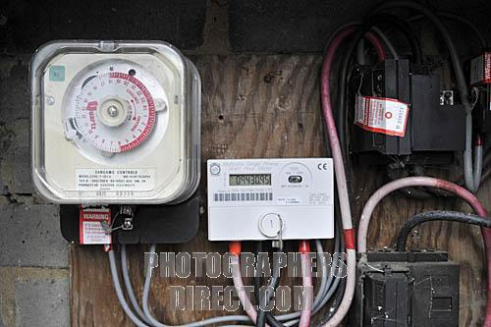
Mains Electricity
The electricity supplied to our homes is called Mains Electricity.
It is an alternating current supply.
In the UK the current changes direction every 1/100th of a second.
This means it completes a complete cycle of changes every 1/50th of a second.
It therefore has a frequency of 50 cycles per second
or 50 hertz (50 Hz).
How electricity arrives into our homes

Slide 6
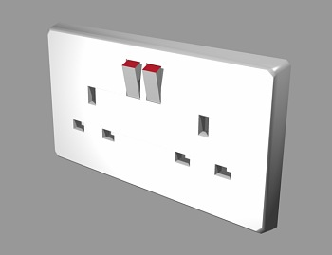
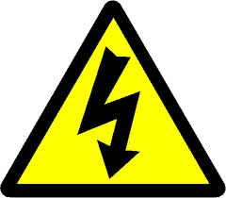
The LIVE and NEUTRAL terminals
UK mains supply is rated at about 230 volts.
This means that it has the same effect as a 230V d.c. battery on devices like a lamp.
One side of the a.c. supply changes constantly between +325V and – 325V.
This terminal is called the LIVE.
Touching this terminal can be fatal!
The other terminal remains at about 0V.
This terminal is called the NEUTRAL.
NEUTRAL
LIVE

Slide 7
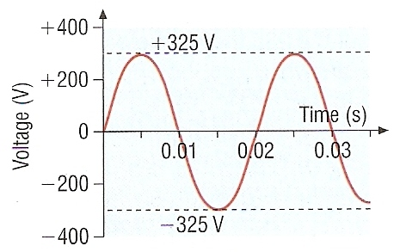
Voltage variation of the LIVE terminal
The voltage of the LIVE terminal varies SINUSOIDALLY between +325V and – 325V taking 1/50th or 0.02 second to complete one complete cycle.

Slide 8
Choose appropriate words to fill in the gaps below:
_______ current (d.c.) is a current that always flows in ____ direction around a circuit. It is supplied by cells and ________.
Alternating current (a.c.) constantly ________ in direction. The _______ supply to our homes is a.c. In this case the a.c. is supplied at an effective voltage of ______ and a frequency of ______.
An _________ can be used to display and __________ a d.c. or a.c. waveform.
Direct
one
batteries
reverses
mains
230V
50Hz
oscilloscope
measure
WORD SELECTION:
batteries
mains
one
50Hz
measure
Direct
230V
oscilloscope
reverses

Slide 9
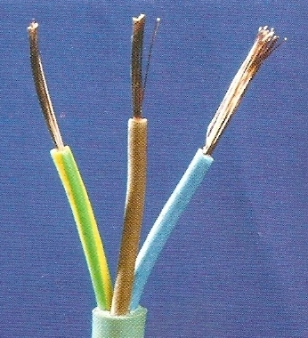
Electrical cable
Electrical cable consists of:
1. A LIVE wire
with BROWN insulation
2. A NEUTRAL wire
with BLUE insulation
and except with some devices with plastic cases
3. An EARTH wire
with YELLOW-GREEN striped insulation.
These are all surrounded by an outer layer made of rubber or flexible plastic.

Slide 10
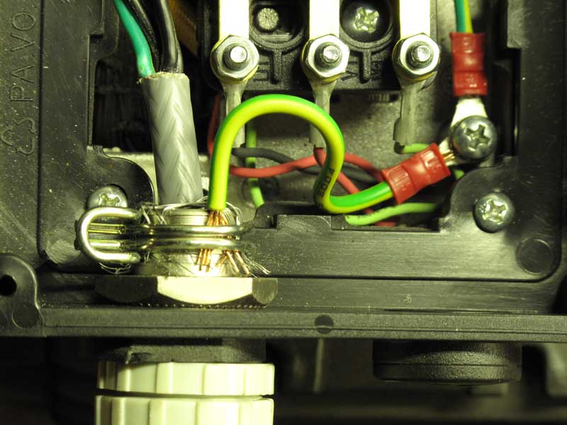
The EARTH wire
This is a safety feature.
The earth wire is connected to the metal casing of a device.
The other end of this wire is connected to a metal rod or pipe that goes into the ground below a building.
Appliances that have plastic cases, for example hairdryers, do not need the earth wire connection.
EARTH

Slide 11
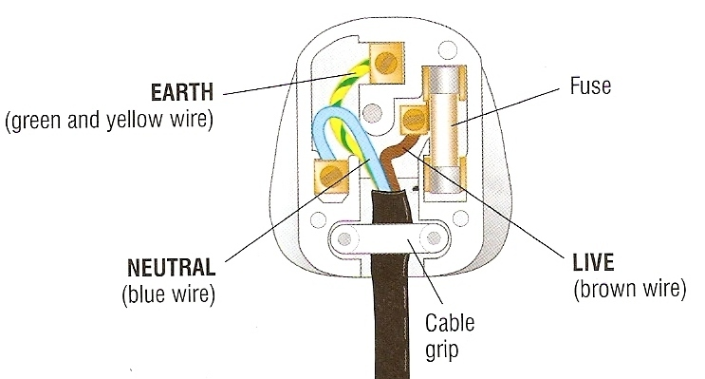
The three pin plug

Slide 12
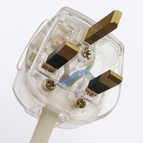
Materials used in plugs, sockets and wires
BRASS – Hard rigid metal and electrical conductor
– used for plug pins and socket terminals
COPPER – Flexible electrical conductor
– used for the wires
PLASTIC – Hard rigid electrical insulator
– used to make the plug and socket
RUBBER – Soft flexible electrical insulator
– used for wire insulation

Slide 13
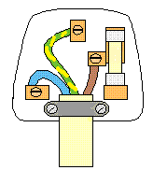
Label this diagram
live
5.
earth
1.
fuse
4.
neutral
2.
cable grip
3.

Slide 14
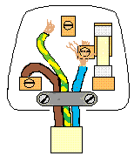
What is wrong with this plug’s wiring?
Earth wire not connected
Wire untidily connected – some bare strands of wire showing
Live and neutral wires swopped over
Cable grip not gripping the outer plastic insulator
Note: The appliance connected with this plug would probably still work but it would be very dangerous to use!

Slide 15
Choose appropriate words to fill in the gaps below:
Most electrical cables contain _______ separately insulated wires. ______-core cables are only used with appliances that have _______ casings.
The live wire has _______ insulation, the neutral has ______and the _______ has striped yellow-green.
In a 3-pin plug the live is connected on the ______ next to the fuse. The neutral is on the ______and the earth is connected at the top.
three
two
plastic
brown
blue
earth
right
left
WORD SELECTION:
plastic
earth
right
left
two
brown
three
blue

Slide 16
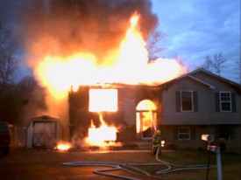
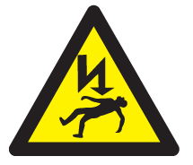
The Dangers of Mains Electricity
The two main dangers of mains electricity are:
1. FIRE
This can be caused by too high a current flowing along cables or through appliances.
A fuse or circuit breaker is used to limit the current to a safe level.
2. ELECTROCUTION
This can occur when contact is made with the LIVE wire. Death can occur if a current above about 100mA (0.1A) flows through the body.
The EARTH wire in combination with a fuse or circuit breaker can prevent electrocution.

Slide 17
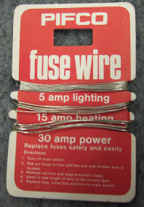
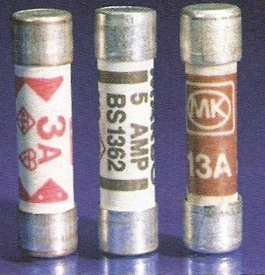
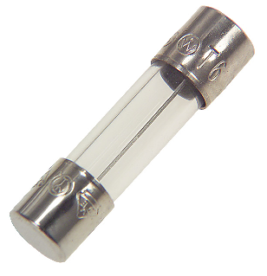
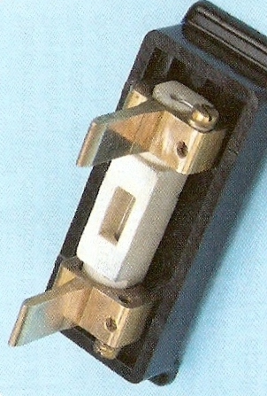
Fuses
A fuse is a length of wire designed to melt and so breaking a circuit when the current passing through it goes above a certain level.
Fuse wires
Cartridge used with fuse wire
Internal fuse from an appliance
3A, 5A and 13A fuses used in 3-pin plugs

Slide 18
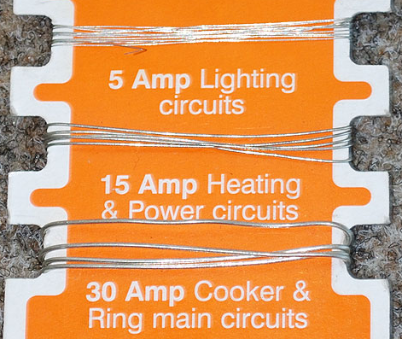
The thicker the fuse wire the greater is the current required to cause it to melt (or fuse).
Fuses are only supplied with a limited number of ratings.
Modern circuit symbol for a fuse

Slide 19
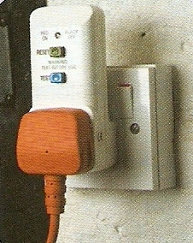
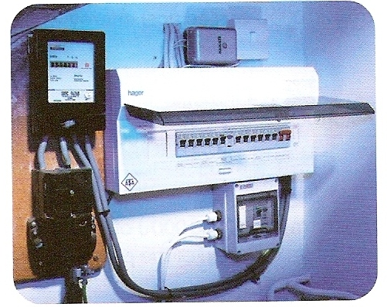
Circuit Breakers
A circuit breaker is an electromagnetic device that breaks a circuit when the current goes above a certain value.
RCD (Residual Current Device) circuit breaker used with an individual appliance
Circuit breakers in a consumer unit

Slide 20
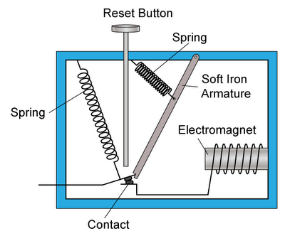
A simple circuit breaker
Current normally flows between terminals A and B through the contact and the electromagnet.
When the current in a circuit increases, the strength of the electromagnet will also increase. This will pull the soft iron armature towards the electromagnet.
As a result, spring 1 pulls apart the contact and disconnecting the circuit immediately, and stopping current flow.
2
1
A
B
The reset button can be pushed to bring the contact back to its original position to reconnect the circuit

Slide 21
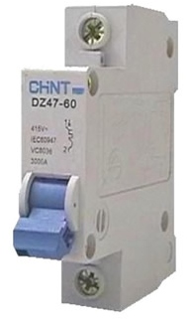
Comparison of fuses and circuit breakers
Comparison of fuses and circuit breakers
Both can prevent fire by limiting the current flowing through a cable or appliance.
Fuses are simple and are cheap to replace.
Circuit breakers act more quickly than fuses and can be reset.

Slide 22
The action of the EARTH wire
Appliances with metal cases such as a tumble dryer are usually earthed by having the EARTH wire connected to their metal case.
Normally current flows to and fro between the LIVE and NEUTRAL wires through the heater of the dryer.
The metal case is at zero volts and is safe to touch.
metal case of tumble dryer
fuse
L
insulation
heater
N
E
earth wire connected to metal case

Slide 23
The action of the EARTH wire
If the LIVE wire became loose inside the dryer it might touch the metal case.
The metal case would now be dangerous to touch and could give a fatal electric shock.
However, the EARTH wire provides a low resistance path to the ground.
metal case of tumble dryer
fuse
L
insulation
heater
N
E
earth wire connected to metal case

Slide 24
The action of the EARTH wire
A large current now flows through the fuse and causes it to melt.
The dryer’s metal casing is now isolated from the LIVE connection and is safe to touch.
metal case of tumble dryer
fuse
L
insulation
heater
N
E
earth wire connected to metal case

Slide 25
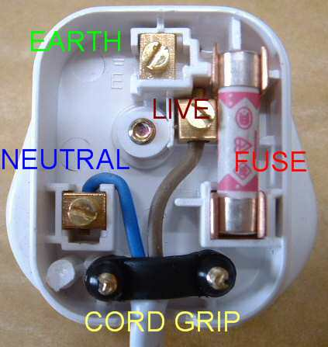
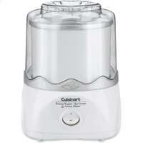
Double insulation
Many electrical appliances have casings made from an insulator such as plastic rather than metal. The electrical parts of the device cannot therefore be touched by the user.
The appliance is said to have double insulation. Such appliances will only have two-wire cables as they do not need the EARTH wire.
Plug wiring for a device with double insulation
Plastic cased food mixer will have double insulation
Symbol found on devices having double insulation

Slide 26
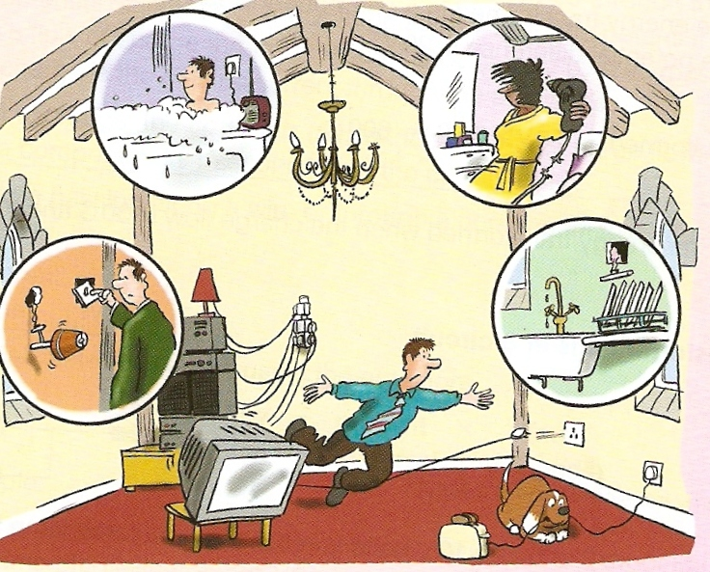
How many dangerous practices can you spot in the picture below?

Slide 27
Choose appropriate words to fill in the gaps below:
Two dangers of mains electricity are ____ and electrocution.
Fires are caused when too high a ________ is allowed to flow along cables. Current can be limited by placing a ______ or circuit breaker in the _____ wire.
The _______ wire is used to prevent the metal casing of an appliance from becoming live should a wiring fault occur. A _______ current flowing down the earth wire will cause the fuse or circuit breaker to _________ the live connection.
fire
current
fuse
live
earth
large
isolate
WORD SELECTION:
current
earth
live
fire
isolate
large
fuse

Slide 28
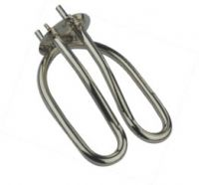
The heating effect of an electric current
House wiring is made of copper wire and is designed to let electric current flow through it easily. It is said to have a low resistance.
However, the parts of some devices such as the heating elements of kettles and toasters are designed to have a high resistance.
Resistance causes heat energy to be produced when an electric current flows.
The greater the resistance and current the hotter the heating element may become.
A kettle’s heating element

Slide 29
Electrical power (P)
The electrical power, P of a device is equal to the rate at which it transforms energy from electrical to some other form (such as heat).
electrical power = energy transferred ÷ time
electrical power is measured in watts (W)
energy in joules (J)
time in seconds (s)
also:
1 kilowatt (kW) = 1 000 watts
1 megawatt (MW) = 1 000 000 watts

Slide 30
Electrical power ratings
These are always shown on an electrical device along with voltage and frequency requirements.

Slide 31
Electrical power examples
Device | Power rating
Torch
1W
Energy efficient lamp
11 W
Desktop computer
300 W
Hairdryer
1 000 W or 1 kW
Electric kettle
2 000 W or 2 kW
Electric shower
5 kW

Slide 32
Question 1
Calculate the power of a light bulb that uses 1800 joules of electrical energy in 90 seconds.
electrical power = electrical energy
time
= 1800 J
90 s
electrical power = 20 watts

Slide 33
Question 2
Calculate the energy used in joules by a heater of power 3kW in 1 hour.
electrical power = electrical energy
time
becomes:
electrical energy = power x time
= 3 kW x 1 hour
= 3000 W x 3600 seconds
electrical energy used = 10 800 000 joules (or 10.8 MJ)

Slide 34
Complete:
Answers
Electrical energy used | Time | Power
600 J | 20 s
 | 15 s | 500 W
800 J |  | 20 W
60 kJ | 10 minutes
30 W
7 500 J
40 s
100 W

Slide 35
Electrical power, P electric current, I and voltage V
electrical power = current × voltage
P = I x V
electrical power is measured in watts (W)
electric current in amperes (A)
voltage in volts (V)

Slide 36
Question 1
Calculate the power of a 230V television that draws a current of 2.5A.
electrical power = current × voltage
= 2.5A x 230V
power = 575W

Slide 37
Question 2
Calculate the current drawn by a kettle of power 2kW when connected to the mains 230V power supply.
P = I x V
becomes:
I = P ÷ V
= 2kW ÷ 230V
= 2000W ÷ 230V
electric current = 8.7A

Slide 38
Complete:
Answers
I | V | P
5 A | 230 V
 | 230 V | 460 W
4 A |  | 48 W
200 mA | 6 V
1150 W
2 A
12 V
1.2 W

Slide 39
Fuse ratings
The equation:
current = electrical power
voltage
is used to find the fuse rating of a device.
The correct fuse rating is that next above the normal current required by an appliance.
Example:
A 5A fuse should be used with a device that needs a current of 3.5A.
A 3-pin plug will normally contain a 3A, 5A or 13A fuse.

Slide 40
Question
Fuses of 3A, 5A and 13A are available. What fuse should be used with a 60W, 230V lamp?
I = P ÷ V
= 60W ÷ 230V
= 0.26A
Fuse to be used = 3A

Slide 41
Complete:
Answers
All of the devices below are 230V mains appliances.
Device and power (W) | Normal current (A) | Fuse choice from: 3A, 5A or 13A
Computer; 300W
Microwave; 900W
Charger; 10W
Heater; 2kW
Maximum power? | 13A | 13A
1.3 A
3A
3.9 A
5A
0.04A
3A
8.7A
13A
2990W

Slide 42
Choose appropriate words to fill in the gaps below:
Electric power is the rate of conversion of electrical _______ to some other form and is measured in ______.
Electrical power is equal to electric current __________ by voltage. The greater the _______ for the same voltage the _________ is the current drawn.
The correct fuse for a device is the next available value _____ the normal current drawn by a device. The maximum fuse rating for a 3-pin plug is _______ for an appliance of power about _______.
energy
watts
multiplied
power
greater
above
13A
3kW
WORD SELECTION:
multiplied
above
13A
watts
power
greater
3kW
energy

Slide 43
Electrical energy E
E = I x V x t
electrical energy (E ) is measured in joules (J)
electric current (I ) in amperes (A)
voltage (V ) in volts (V)
time (t ) in seconds (s)

Slide 44
Question 1
Calculate the energy used in joules by a 12V car starter motor when drawing a current of 80A for 3 seconds.
E = I x V x t
= 80A x 12V x 3s
electrical energy used = 2 880J
Notes:
44

Slide 45
Question 2
Calculate the energy used in joules by a hairdryer of power 1kW in 1 hour.
E = I x V x t
but electrical power P = I x V
and so: E = P x t
= 1 kW x 1 hour
= 1000 W x 3 600 seconds
electrical energy used = 3 600 000 joules (or 3.6 MJ)
Notes:
45

Slide 46
Complete:
Answers
P | I | V | t | E
50W | 10A | 5V | 4s | 200J
100W | 2A | 50V | 8s | 800J
90W | 3A | 30V | 5s | 450J
2kW | 8A | 250V | 3 min | 360 kJ
1
2
3
4
5
6
7
8

Slide 47
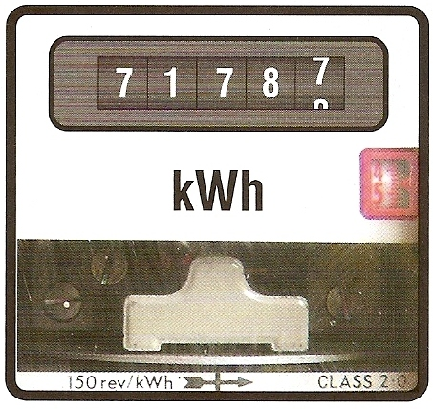
Paying for electricity
An electricity meter is used to measure the usage of electrical energy.
The meter measures in kilowatt-hours (kWh)
A kilowatt-hour is the electrical energy used by a device of power one kilowatt in one hour.
Notes:
47

Slide 48
Calculating cost
1 . Calculate kilowatt-hours used from:
kilowatt-hours = kilowatts x hours
2 . Calculate cost using:
cost in pence = kilowatt-hours x cost per kWh
Electricity currently costs about 12p per kWh
Notes:
48

Slide 49
Question 1
Calculate the cost of using an electric heater of power 2kW for 5 hours if each kWh costs 12p.
kilowatt-hours = kilowatts x hours
= 2kW x 5 hours
= 10 kWh
cost in pence = kilowatt-hours x cost per kWh
= 10 kWh x 12p
= 120p
cost of using the heater = £1.20
Notes:
49

Slide 50
Question 2
Calculate the cost of using a mobile phone charger power 10W for 6 hours if each kWh costs 12p.
kilowatt-hours = kilowatts x hours
= 10W x 6 hours
= 0.01 kW x 6 hours
= 0.06 kWh
cost in pence = kilowatt-hours x cost per kWh
= 0.06 kWh x 12p
cost of using the heater = 0.72p
Notes:
50

Slide 51
Electricity bill
Calculate the cost of the electricity that you use over a three month period (90 days).
Typical power values:
energy efficient light bulb – 15 W
desk-top computer – 300 W
hairdryer – 2 kW
television – 100 W
charger – 10 W
Example: light bulb used for 4 hours per day:
kWh = (0.015 x 4 x 90) = 5.4 kWh; cost = 5.4 x 12p = 64.8p
Notes:
51

Slide 52
Questions 3
What causes heating in an electrical circuit?
Describe how the following increase electrical safety: (a) fuses; (b) circuit breakers; (c) earthing; (d) double insulation
(a) What is electrical power? (b) State how power is related to other electrical quantities. (c) Calculate the current drawn by a device of power 2.5kW when connected to the 230V mains supply.
What is the maximum power of an appliance that should be used with a 3A fuse?
How much electrical energy is used by a 2kW heater in three hours?
What is the difference between alternating and direct current?

