Slide 1
IGCSE PHYSICS Forces – Hooke’s Law
Textbook pages 60-61

Slide 2
IGCSE Specification
1.5 Effects of Forces
Core
• State that a force may produce a change in size and shape of a body
• Plot extension/load graphs and describe the associated experimental procedure
Supplement
• Interpret extension/load graphs
• State Hooke’s Law and recall and use the expression F = k x
F= Force k = spring constant x= extension length
• Recognise the significance of the term ‘limit of proportionality’ for an extension/load graph

Slide 3
Changing shape
Force can also change the shape of an object.
A stretching force puts an object such as a wire or spring under tension.
A squashing force puts an object under compression.

Slide 4
Hooke’s Law Glossary
Elastic materials return to their original shape when the forces on them are removed.
Plastic materials retain their new shape, when forces are removed
Hooke’s Law - The extension of a spring or wire is directly proportional to the force applied provided the limit of proportionality is not exceeded.
Spring constant is the gradient of the force (x- axis) against extension (y-axis) the gradient is the spring constant Units N/m
A stretching force puts an object such as a wire or spring under tension
The limit of proportionality is the is the point beyond which Hooke’s law is no longer true when stretching a material.
The elastic limit is the point beyond which the material you are stretching becomes permanently stretched so that the material does not return to its original length when the force is removed.
• A squashing force puts an object under compression.

Slide 5
Brittle materials such as glass do not change shape easily and break before noticeably stretching.
Resilient materials do not break easily.

Slide 6
Elastic materials return to their original shape when the forces on them are removed.
Plastic materials retain their new shape.

Slide 7
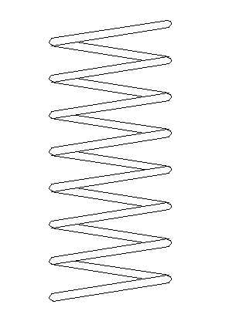
Stretching Springs
Experimental procedure:
1. Place the weight holder only on the spring and note the position of the pin against the metre rule.
2. Add 1N (100g) to the holder and note the new position of the pin.
3. Calculate the extension of the spring.
4. Repeat stages 1 to 3 for 2N, 3N, 4N, 5N and 6N. DO NOT EXCEED 6N.
spring
weights
pin
metre rule
Notes:
7

Slide 8
Typical results
Pin position with holder only (mm) | Added weight or Force (N) | Pin position with weight (mm) | Extension (mm)
450 | 1 | 480 | 30
450 | 2 | 509 | 59
450 | 3 | 541 | 91
450 | 4 | 570 | 120
450 | 5 | 601 | 151
450 | 6 | 629 | 179
Notes:
8

Slide 9
Force against extension graph
Force (N)
0
0
Extension (mm)
Notes:
9

Slide 10
Hooke’s law
Hooke’s law states that the extension of a spring force is proportional to the force used to stretch the spring.
‘Proportional’ means that if the force is doubled then the extension also doubles.
The line on a graph of force against extension will be a straight AND go through the origin.

Slide 11
When a material obeys Hooke’s Law, the force is proportional to the extension of the material.
Force ∼ Extension
F ∼ x
This leads to the equation:
F = kx
Where k is a measure of the stiffness of the sample
– the gradient of a force / extension graph.

Slide 12
Force-Extension Graphs
10
x
x
x
x
x
Force (N)
x
5
x
x
x
x
0
x
0
0.25
0.5
Extension (m)

Slide 13
Extension Work
Sketch a force-extension graph (the line should be roughly halfway between your axes).
Sketch a second line for a stiffer spring (harder to stretch).
Sketch a third line for a less stiff spring (easier to stretch).
Explain each line, relating the force to the extension.

Slide 14
Force-Extension Graphs

Slide 15
Force-Extension Graphs

Slide 16
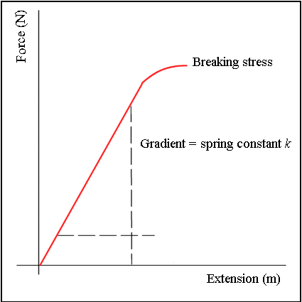
Force-Extension Graphs

Slide 17
Question
A spring of original length 150mm is extended by 30mm by a force of 4N. Calculate the length of the spring if a force of 12N is applied.
12N is three times 4N
Therefore the new extension should be 3 x 30mm
= 90mm
New spring length = 150mm + 90mm
= 240mm

Slide 18
Elastic limit
Up to a certain extension if the force is removed the spring will return to its original length. The spring is behaving elastically.
If this critical extension is exceeded, known as the elastic limit, the spring will be permanently stretched.
Hooke’s law is no longer obeyed by the spring if its elastic limit is exceeded.
The right hand spring has been stretched beyond its elastic limit

Slide 19
Force against extension graph if the elastic limit is exceeded
Force (N)
elastic limit
0
0
Extension (mm)
Notes:
19

Slide 20
Stretching an elastic band
Force
An elastic band does not obey Hooke’s law.
0
0
Extension
Notes:
20

Slide 21
Choose appropriate words to fill in the gaps below:
Hooke’s law states that when a wire or spring is _________ the increase in length or _________ is proportional to the load ______ applied.
This law is not obeyed if the spring is taken beyond its ______ limit after which it will become _____________ stretched.
A ________ band does not obey Hooke’s law.
A graph illustrating Hooke’s law will have a line that is ___________ and passes through the _______.
stretched
extension
force
elastic
permanently
rubber
straight
origin
WORD SELECTION:
stretched
elastic
permanently
extension
origin
force
rubber
straight
Notes:
21

Slide 22
USEFUL LINKS
Online Simulations
Stretching Springs - PhET - A realistic mass and spring laboratory. Hang masses from springs and adjust the spring stiffness and damping. You can even slow time. Transport the lab to different planets. A chart shows the kinetic, potential, and thermal energy for each spring.
Hooke’s Law
https://www.youtube.com/watch?v=WUWMgI438Lg

