Slide 1
Volume and Density
Measuring volume and density

Slide 2
Volume is the amount of space an object takes up.
SI unit of volume is the cubic metre - m³, but for convenience we often use litre – L or millilitre ml.
Mass is the amount of matter an object is made of.
SI unit of mass is kilogram – kg.
To describe how concentrated mass of some material is we use density
Density is defined as mass per unit volume.
Density = ρ - density

Slide 3
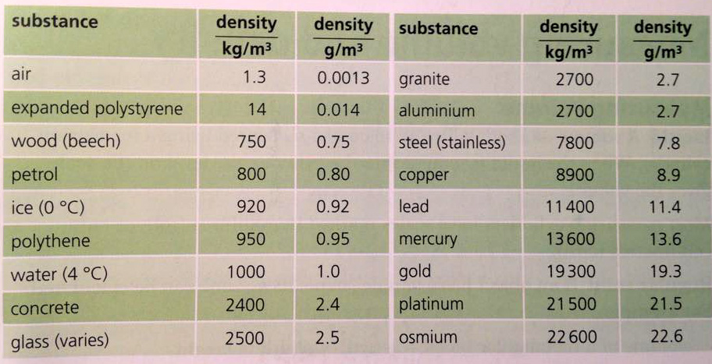
the densities of solids and liquids vary slightly with temperature
the densities of gases can vary enormously depending how compressed they are

Slide 4
Density calculations
A sample of ethanol has a volume of 240 cm³. Its mass is found to be 190 g. What is the density of ethanol?
Express the result with two significant figures.
from the density triangle
m
ρ
V

Slide 5
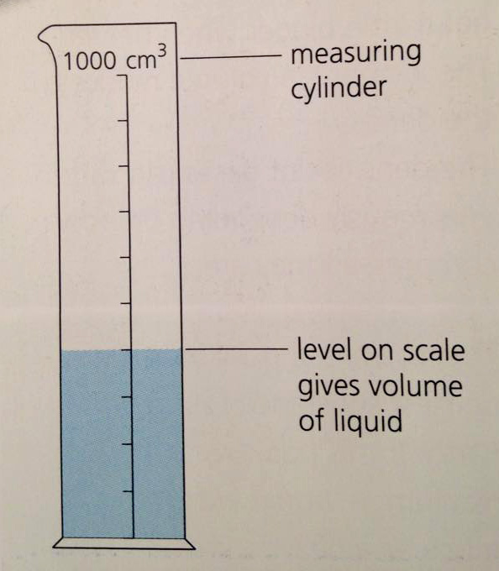
Determining the density of a liquid
To determine density of a liquid, we need mass and volume.
Apparatus:
Measuring cylinder
Beam balance
Procedure:
1. Measure the mass of an empty measuring
cylinder and record it as m₁ in grams.
2. Pour the given liquid into a measuring cylinder
and take the readings in cm³(same as ml).
3. Measure the mass of the measuring cylinder
with water in it and record it as m₂ in grams.
4. Calculate the mass of the liquid:
Mass of liquid = m₂ – m₁
5. Calculate the density of the liquid
Density of liquid = mass of liquid / volume

Slide 6
Density of a regular solid
To calculate the density of a regular solid, you need mass and volume.
The mass of the solid can be measured using a beam balance.
The volume of the solid is calculated using the formula:
volume of a rectangular block = length × width × height
volume of a cylinder = π × radius² × height
h
w
l

Slide 7
Measuring density of a regular solid
Apparatus:
Rule/Vernier caliper/Micrometer screw gauge
Beam balance
Measure the length, width and height of the solid block.
Calculate the volume.
Measure the mass of the block.
Calculate the density.

Slide 8
Density of an irregular solid
1. Using submissive method
Use a beam balance to measure the mass of a solid. Record it as m.
Half-fill a measuring cylinder with water. Measure and record the volume as V₁.
Carefully lower the irregular solid into the measuring cylinder. The level of the water rises.
Record the new volume as V₂.
Calculate the volume of the solid using:
Volume of irregular solid = V₂ – V₁
Calculate the density of the irregular solid.

Slide 9
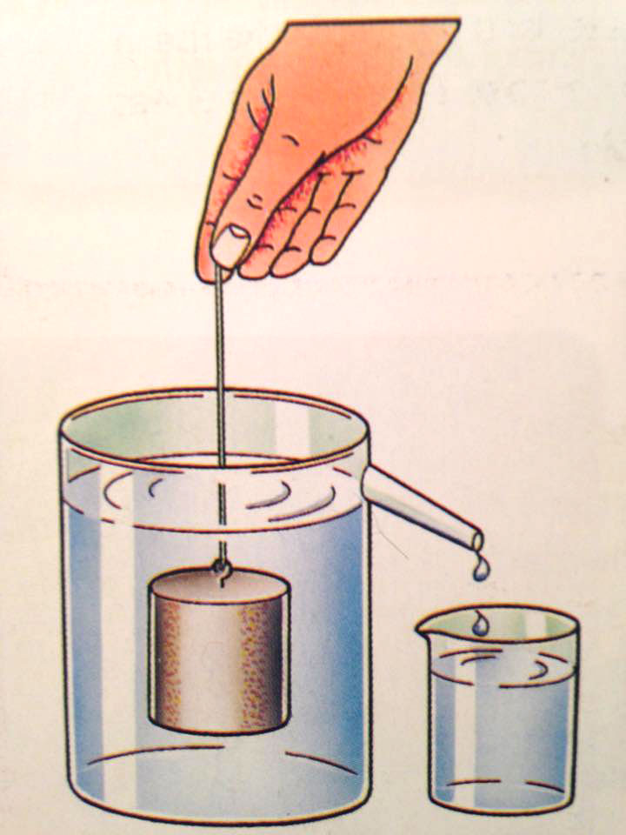
Measuring the volume of a small solid

Slide 10
2. Using a displacement can
Measure and record the mass of the irregular solid using a beam balance and record it as m.
Lower the solid into the displacement can.
The volume of water collected in a beaker is equivalent to the volume of the solid.
Empty the displaced water from the beaker into a measuring cylinder and record the volume V.
Calculate the density of the solid.
This method was discovered by accident, by Greek mathematician Archimedes.

Slide 11
Question
A student is collecting water as it runs into a measuring cylinder. She uses a clock to measure the time interval between measurements. Figure shows the level of water in the cylinder at two times, together with the clock at these times. Calculate:
a the volume of water collected
between these two times
b the time interval

