Slide 1
Chapter 1
UNITS AND MEASUREMENT

Slide 2
Measuring matters
Over the centuries, people have used a wide variety of units for making measurements. Most of them were based on the human body. Here are some examples.
The foot(unit of length) was originally the length of Roman’s foot.
The yard(English unit of length) was defined as the distance from the tip of King Henry I’s nose to the end of his outstretched arm.
The hand(unit of length) is the width of an average hand(it is still used for measuring the height of horses).
The acre(unit of area)was the area of a field that could be ploughed in one day by a team of two oxen.

Slide 3
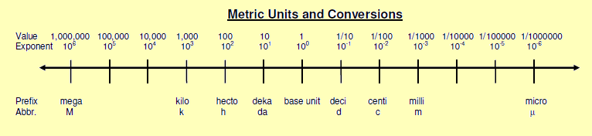
Metric system
Most scientists now use units based on the metric system - system of measuring based on the power of 10.
This system uses prefixes to denote smaller and larger values.
Some prefixes missing from the pictures are: G(giga), T(tera), n(nano), p(pico ), f(femto) …

Slide 4
Examples from nature:
6.4 Mm = radius of the Earth
10 µm = size of a white blood cell
0.154 nm = distance between carbon nuclei in an ethane molecule
British Imperial system of units is using inches, feet, yard…
12 inches=1 foot
3 feet=1 yard
22 yards=1 chain
10 chains=1 furlong
8 furlongs= 1 mile

Slide 5
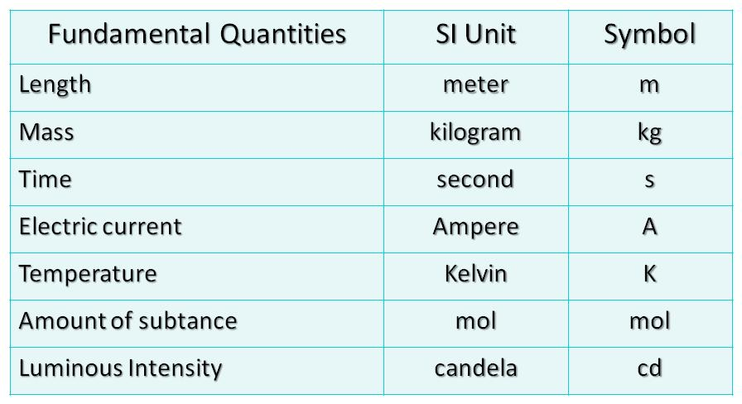
SI units(The International System of Units)
The SI is founded on seven SI base units for seven base quantities assumed to be mutually independent.

Slide 6
Derived quantities
Defined in terms of the seven base quantities via a system of quantity equations.
mass density ρ kg/m³
acceleration a m/s²
magnetic flux Weber Wb = Vs = kgm²/s²A
energy Joule J = kgm²/s²
pressure Pascal Pa= N/m²= kg/(ms²)
power Watt W= J/s = kgm²/s³
magnetic induction Tesla T=Wb/m²= kg/s²A

Slide 7
MKS (Meter-Kilogram-Second)system
Many units are based on these
The metre m is the SI unit of length.
The kilogram kg is the SI unit of mass.
The second s is the SI unit of time.
Mass is the amount of matter in something.
Volume is the amount of space something takes up.
SI unit of volume is cubic metre.

Slide 8
Useful links:
International System of Units
http://www.britannica.com/science/International-System-of-Units
British Imperial System of Units
http://www.britannica.com/science/British-Imperial-System
Useful conversions
1 inch = 2.54 cm
An object with a weight on Earth of 2.2 pounds has a mass of 1 kg.
2.2lb=1kg

